Slide 1

SEMINARIO INGEGNERIA DEL SOFTWARE a.a. 2006/2007
INTERNET MOVIE DATABASE
Studente: Cristiano Sticca
Docente: Prof. Giuseppe De Giacomo

Slide 2
OBIETTIVI
Creazione di un DB locale rappresentante tutti i film prodotti dall’inizio della cinematografia ad oggi
Generazione schema ER dell’ “INTERNET MOVIE DB”
Realizzazione schema logico
Realizzazione schema fisico
Creazione ontologia in DL-Lite_{A}
Creazione mapping tra DB e ontologia
Verifica su QuOnto (sviluppi futuri)

Slide 3
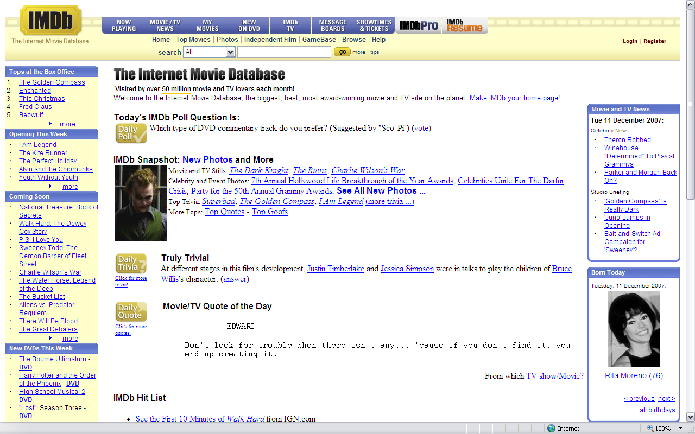
Il sito internet...

Slide 4
PROBLEMATICHE
Realizzazione di parser java per la creazione di script SQL
Identificazione struttura dei file importati dal sito http://imdb.com/interfaces#win32
Tempo per popolare il DB!!!

Slide 5
File from IMDb…
Il sito www.imdb.com permette il download di determinati file che rappresentano il contenuto del DB su internet al seguente indirizzo http://imdb.com/interfaces
Come accennato precedentemente, il problema sostanziale è che tali file (40 circa) hanno una formattazione pressochè diversa l’uno dall’altro.
E questo quindi ha comportato la realizzazione di altrettanti parser scritti in Java.

Slide 6
File from IMDb… an example
Vediamo come possono essere strutturati alcuni di questi file.
Consideriamo i seguenti: movies.LIST and actors.LIST
Per una questione di leggibilità sono stati rinominati in .txt

Slide 7
movies.LIST
CRC: 0x9A686F55 File: movies.list Date: Fri Sep 14 01:00:00 2007
Copyright 1991-2007 The Internet Movie Database Ltd. All rights reserved.
http://www.imdb.com
movies.list
2007-09-12
----------------------------------------------------------------------------
MOVIES LIST
===========
#1 (2005) 2005
#1 Fan: A Darkomentary (2005) (V) 2005
#28 (2002) 2002
#2: Drops (2004) 2004
#7 Train: An Immigrant Journey, The (2000) 2000
$ (1971) 1971
$1,000 Reward (1913) 1913
$1,000 Reward (1915) 1915
$1,000 Reward (1923) 1923
$1,000,000 Reward, The (1920) 1920
$10,000 Under a Pillow (1921) 1921

Slide 8
Parser Java per movies.LIST
public class movies {
public static void main (String[] args) throws Exception{
String primo,secondo;
secondo = null;
int movieid=0;
String[]res;
FileWriter fi = new FileWriter("G:\\Documents and Settings\\cristiano\\Desktop\\tesina seminario\\tesina\\finalScripts\\movies.sql");
PrintWriter out=new PrintWriter(fi);
FileReader f = new FileReader("G:\\Documents and Settings\\cristiano\\Desktop\\tesina seminario\\tesina\\file IMDB\\movies.txt");
BufferedReader filebuf = new BufferedReader(f);
String nextStr;
nextStr = filebuf.readLine();
while (!nextStr.equals("MOVIES LIST")){
nextStr = filebuf.readLine();
}
nextStr = filebuf.readLine();
nextStr = filebuf.readLine();
out.print("INSERT IGNORE INTO movies VALUES\n");
while (nextStr!=null){
if (nextStr.equals("-----------------------------------------------------------------------------")){
System.out.println("Movies inseriti nel db");
break;
}
Crea lo Script SQL
Legge il file sorgente
Inserisce valori nello script

Slide 9
…
nextStr=nextStr.replace("'","");
res=nextStr.split("\t");
for (int x=1; x<res.length; x++){
if (!res[x].equals("\t")){
secondo= res[x];
}
}
primo=res[0];
if (primo.contains("(")){
int indice = primo.indexOf("(");
primo = primo.substring(0,indice);
}
out.append("('"+movieid+"','"+primo+"','"+secondo+"',null,null,null,null,null,null,null,null,null),\n");
nextStr = filebuf.readLine();// legge una riga del file
movieid++;
}
filebuf.close(); // chiude il file
out.close();
}
}
Utilizziamo i “multiple inserts” per velocizzare le operazioni in fase di popolamento

Slide 10
actors.LIST (relativo alle attrici)
THE ACTRESSES LIST
==================
Name Titles
---- ------
'La Mueque' Tarantos, Los (1963) [Cantaor] <17>
'La Tata' Castro, Maria Tereza "Granja tolima, La" (2004) [Herself]
'La Veneno', Cristina Secreto de la veneno, El (1997) (V) <1>
Venganza de la veneno, La (1997) (V) <1>
"Aquí hay tomate" (2003) {(2006-10-11)} [Herself]
't Hart, Josine Barbiere di Siviglia, Il (1992) (TV) [Mime artists] <11>
Nieuwe moeder, De (1996) [Vrouw in trein] <23>
't Seyen, Hilda Moedige bruidegom, De (1952) [Moeder van Tinneke]

Slide 11
Parser Java per actors.LIST
public class actresses {
public static void main (String[] args) throws Exception{
/*variabili*/
FileWriter fi = new FileWriter("G:\\Documents and Settings\\cristiano\\Desktop\\tesina seminario\\tesina\\finalScripts\\actresses.sql");
PrintWriter out=new PrintWriter(fi);
FileWriter fi3 = new FileWriter("G:\\Documents and Settings\\cristiano\\Desktop\\tesina seminario\\tesina\\finalScripts\\actresses2movie.sql");
PrintWriter out3=new PrintWriter(fi3);
FileReader f = new FileReader("G:\\Documents and Settings\\cristiano\\Desktop\\tesina seminario\\tesina\\file IMDB\\actresses.txt");
BufferedReader filebuf = new BufferedReader(f);
Connection conn2 = null;
ResultSet rs3=null;
try
{
String userName = "root";
String password = "041524";
String url = "jdbc:mysql://localhost/imdb";
Class.forName ("com.mysql.jdbc.Driver").newInstance ();
conn2 = DriverManager.getConnection (url, userName, password);
//System.out.println ("Database connection established");
}
catch (Exception e)
{
e.printStackTrace();
System.err.println ("Cannot connect to database server");
}
Connessione al DB

Slide 12
out.print("INSERT IGNORE INTO actor VALUES\n");
out3.print("INSERT IGNORE INTO actor2movie VALUES\n");
String nextStr;
nextStr = filebuf.readLine();
while (!nextStr.equals("THE ACTRESSES LIST")) {
nextStr=filebuf.readLine();
}
nextStr = filebuf.readLine();
nextStr = filebuf.readLine();
nextStr = filebuf.readLine();
nextStr = filebuf.readLine();
nextStr = filebuf.readLine();
}
while (nextStr!=null){
try{
if (nextStr.equals("SUBMITTING UPDATES")){
System.out.println("Actresses inseriti nel db");
break;
}
nextStr = nextStr.replace("'","");
if(nextStr.equals("")){
attoreid++;
nextStr=filebuf.readLine();
}
if (nextStr.startsWith("\t")){
secondo=nextStr;
secondo=secondo.replace("'","");
secondo=secondo.replace("\t","");
if (secondo.contains("(")){
int aperta=secondo.indexOf("(");
int chiusa=secondo.indexOf(")");
year = secondo.substring(aperta+1,chiusa);
}

Slide 13
else {year=null; }
if (secondo.contains("[")){
int aperta2=secondo.indexOf("[");
int chiusa2=secondo.indexOf("]");
as = secondo.substring(aperta2+1,chiusa2); }
else {as=null; }}
else {
primo=nextStr;
primo=primo.replace("'","");
int tab=primo.indexOf("\t");
nomecognome = primo.substring(0,tab);
if (nomecognome.contains(",")){
int virgola=nomecognome.indexOf(",");
cognome = nomecognome.substring(0,virgola);
nome= nomecognome.substring(virgola+2,tab); }
else {nome = null;
cognome = nomecognome; }
out.append("('"+attoreid+"','"+nome+"','"+cognome+"','F'),\n");
secondo=primo.substring(tab);
secondo=secondo.replace("'","");
secondo=secondo.replace("\t","");
if (secondo.contains("(")){
int aperta=secondo.indexOf("(");
int chiusa=secondo.indexOf(")");
year = secondo.substring(aperta+1,chiusa); }
else {year=null;}
if (secondo.contains("[")){
int aperta2=secondo.indexOf("[");
int chiusa2=secondo.indexOf("]");
as = secondo.substring(aperta2+1,chiusa2);
}
else {
as=null;
}
Utilizziamo i “multiple inserts” per velocizzare le operazioni in fase di popolamento

Slide 14
}
if (secondo.contains("[")){
int quadra=secondo.indexOf("[");
secondo=secondo.substring(0,quadra);
}
if (secondo.contains("(")){
int tonda=secondo.indexOf("(");
secondo=secondo.substring(0,tonda);
}
try{
Statement s2 = conn2.createStatement();
rs3=s2.executeQuery("SELECT id FROM movies WHERE title='"+secondo+"' and year='"+year+"'");
rs3.last();
movieid =(Integer)rs3.getObject(1);
}
catch(Exception e){
}
out3.append("('"+attoreid+"','"+movieid+"','"+as+"'),\n");
nextStr = filebuf.readLine();// legge una riga del file
}
catch(Exception e){
e.printStackTrace();
break;
}
}
filebuf.close(); // chiude il file
out.close();
}
}
query al DB per trovare l'id del film
"multiple insert" nella relazione actor2movie

Slide 15
script SQL (movies)
NOTARE L'INSERIMENTO MULTIPLO
INSERT IGNORE INTO movies VALUES
('1','#1 ','2005',null,null,null,null,null,null,null,null,null),
('2','#1 Fan: A Darkomentary ','2005',null,null,null,null,null,null,null,null,null),
('3','#28 ','2002',null,null,null,null,null,null,null,null,null),
('4','#2: Drops ','2004',null,null,null,null,null,null,null,null,null),
('5','#7 Train: An Immigrant Journey, The ','2000',null,null,null,null,null,null,null,null,null),
('6','#Bfl O {ggGX = STwWcfl x 2s4 ','1963',null,null,null,null,null,null,null,null,null),
('7','$ ','1971',null,null,null,null,null,null,null,null,null),
('8','$1,000 Reward ','1913',null,null,null,null,null,null,null,null,null),
('9','$1,000 Reward ','1915',null,null,null,null,null,null,null,null,null),
('10','$1,000 Reward ','1923',null,null,null,null,null,null,null,null,null),
('11','$1,000,000 Reward, The ','1920',null,null,null,null,null,null,null,null,null),
('12','$10,000 Under a Pillow ','1921',null,null,null,null,null,null,null,null,null),
('13','$100 & a T-Shirt: A Documentary About Zines in the Northwest ','2004',null,null,null,null,null,null,null,null,null),
('14','$100,000 ','1915',null,null,null,null,null,null,null,null,null),
('15','$100,000 Bill, The ','1915',null,null,null,null,null,null,null,null,null),
('17','$100,000 Pyramid, The ','2001',null,null,null,null,null,null,null,null,null),

Slide 16
script SQL (actors)
INSERT IGNORE INTO actor VALUES('1','null','La Mueque','F'),('2','Maria Tereza','La Tata Castro','F'),('3','Cristina','La Veneno','F'),('4','Josine','t Hart','F'),('5','Hilda','t Seyen','F'),('6','Moni','ya','F'),('7','Martha','103','F'),('8','Sharon','10X','F'),('9','Nicole','11:11','F'),('10','null','12 Elite Girls','F'),('11','Die','12 Elite Girls','F'),('12','Rachel','18','F'),('13','null','1988 Montclair Squad','F'),('14','Die','20 Wienerinnen','F'),('15','null','2004 Buffalo Jills Cheerleaders','F'),('16','Diamond','4 Ever','F'),('17','null','4 Non Blondes','F'),('18','Colt','45','F'),('19','Cat','9','F'),('20','Kat','9','F'),('21','Suilma','AAlitaleb','F'),('22','Mrs.','ACosta','F'),('23','Michele','ACourt','F'),
INSERT IGNORE INTO actor2movie VALUES ('91784','425331','Edith'),('91784','443564','Kamen'),('91784','478275','Sister Candida'),('91784','478583','null'),('91785','33484','Corinna Gerber'),('91785','178468','null'),('91785','278096','null'),('91785','314761','Rosi'),('91785','314810','null'),('91785','383550','null'),('91785','497686','Erika Hanson'),('91785','536953','Selma Kremer'),

Slide 17
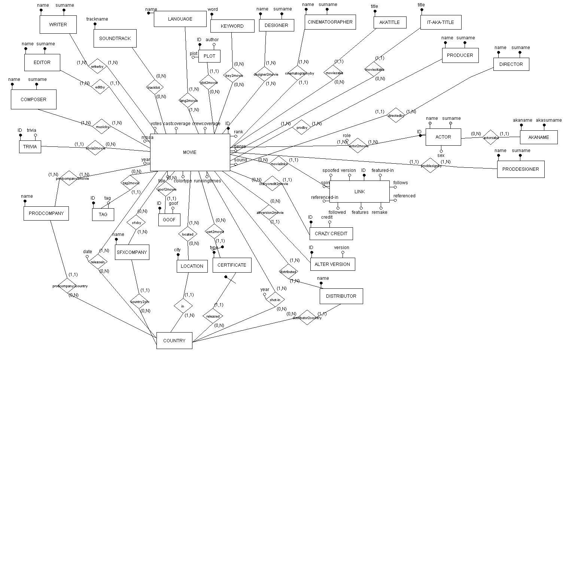
Schema ER

Slide 18
Schema Logico
MOVIES(ID,title,year,runtime,sound,genre,colortype,castcoverage,crewcoverage,votes,rank,mpaa)
inclusione: MOVIES[ID] ⊆ releasein[MOVIE]
inclusione: MOVIES[ID] ⊆ musicby[MOVIE]
inclusione: MOVIES[ID] ⊆ lang2movie[MOVIE]
inclusione: MOVIES[ID] ⊆ writerby[MOVIE]
inclusione: MOVIES[ID] ⊆ prodcompany2movie[MOVIE]
inclusione: MOVIES[ID] ⊆ actor2movie[MOVIE]
inclusione: MOVIES[ID] ⊆ prodby[MOVIE]
inclusione: MOVIES[ID] ⊆ designer2movie[MOVIE]
inclusione: MOVIES[ID] ⊆ distributor[MOVIE]
inclusione: MOVIES[ID] ⊆ located[MOVIE]
inclusione: MOVIES[ID] ⊆ shotin[MOVIE]
FK: MOVIES[ID] ⊆ editby[MOVIE]
FK: MOVIES[ID] ⊆ proddesignby[MOVIE]
FK: MOVIES[ID] ⊆ directedby[MOVIE]
FK: MOVIES[ID] ⊆ cinematographyby[MOVIE]
……

Slide 19
Schema Fisico
create table movies (
id int(8) primary key,
title varchar(200),
year varchar(100),
runtimes varchar(100),
sound varchar(100),
genre varchar(100),
colortype varchar(100),
crewcoverage varchar(100),
castcoverage varchar(100),
votes int(8),
rank float,
mpaa longtext,
index(title),
index(title,year),
unique(title,year),
check (id in (select movie from musicby)),
check (id in (select movie from writerby)),
check (id in (select movie from actor2movie)),
check (id in (select movie from prodby)),
check (id in (select movie from designer2movie)),
check (id in (select movie from distributor)),
check (id in (select movie from located)),
check (id in (select movie from shotin))
check (id in (select movie from releasein))
);

Slide 20
Ontologia
“Descrizione formale esplicita dei concetti di un dominio”.
Essa contiene:
Un insieme di classi (concetti rilevanti)
Un insieme di relazioni tra queste classi
Un insieme di proprietà attribuite a ciascun concetto
Un insieme di restrizioni sulle proprietà

Slide 21
Description Logic
Le logiche descrittive (DL) sono frammenti decidibili della
FOL per esprimere la conoscenza in termini di:
concetti atomici (predicati unari)
ruoli atomici (predicati binari)
individui (costanti)
Una base di conoscenza in DL comprende:
TBox: insieme di assiomi terminologici, ovvero il vocabolario del dominio applicativo (concetti e ruoli)
ABox: contiene asserzioni circa gli individui che
popolano il mondo in oggetto, assegnando loro un nome e asserendo le loro proprietà

Slide 22
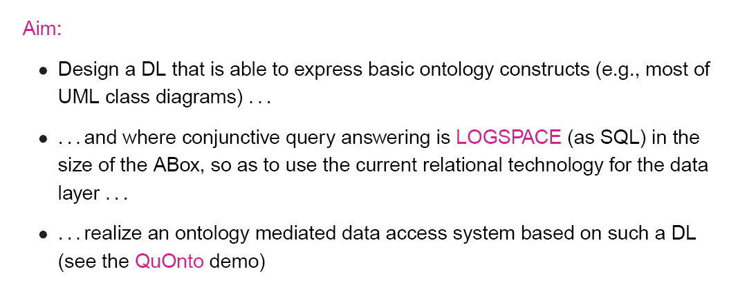

DL-Lite program

Slide 23
DL-Lite
Capturing basic ontology constructs in DL-Lite
ISA between classes → A1 ⊑ A2
disjointness between classes → A1 ⊑ ￢A2
domain and range of relations → ∃P ⊑ A1 ∃P⁻⊑ A2
mandatory participation → A1 ⊑ ∃P A2 ⊑ ∃P⁻
functionality of relations (in DL-Lite_{F})→ (funct P) (funct P)
ISA between relations (in DL-Lite_{R})→ R1 ⊑ R2

Slide 24
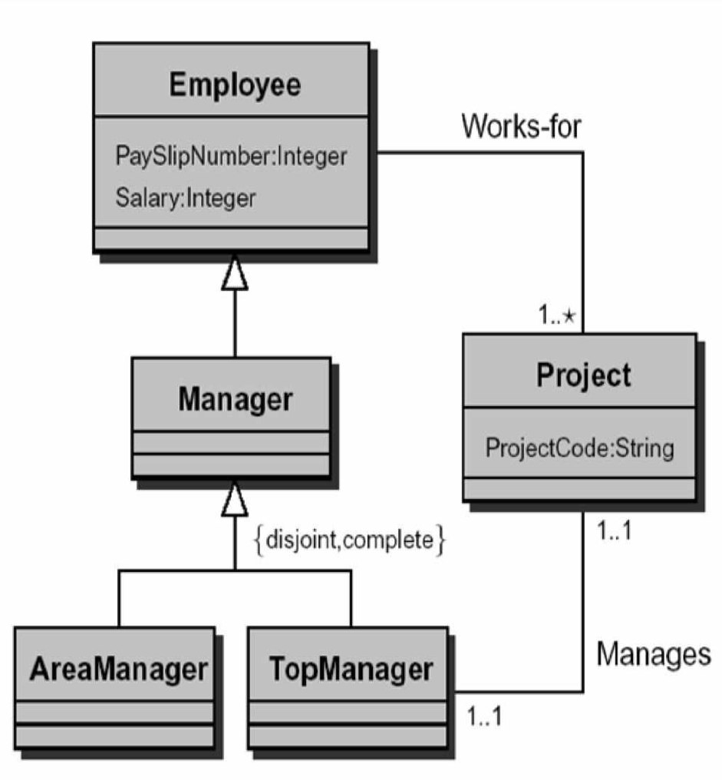
DL-Lite example
Manager ⊑ Employee
AreaManager ⊑ Manager
TopManager ⊑ Manager
AreaManager ⊑ ￢TopManager
∃WorksFor ⊑ Employee
∃WorksFor− ⊑ Project
Project ⊑ ∃WorksFor−
(funct WorksFor)
(funct WorksFor−)
...
Note: in DL-Lite we cannot capture
completeness of the hierarchy

Slide 25
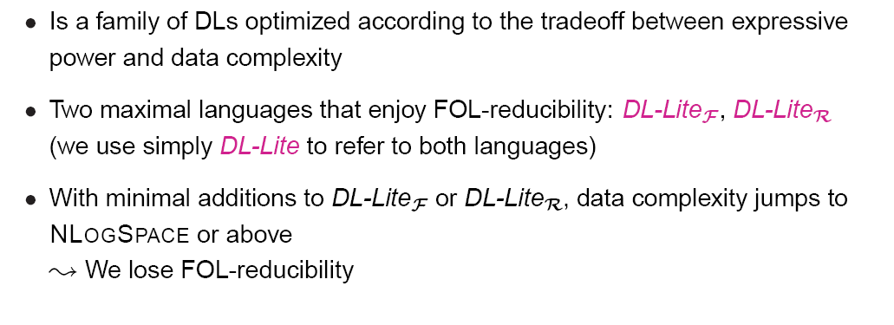
DL-Lite family

Slide 26
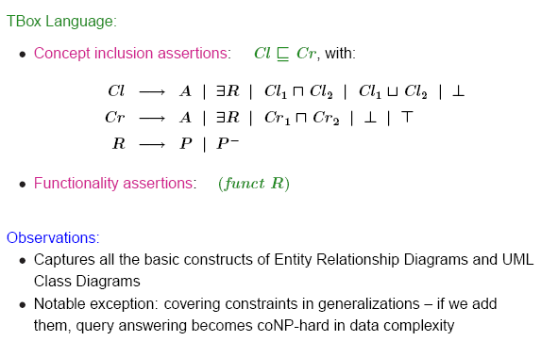
DL Lite_{F}

Slide 27
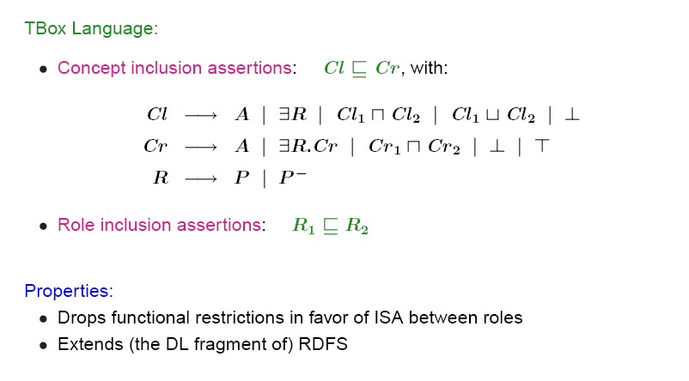
DL Lite_{R}

Slide 28
DL Lite_{A} (combines the main features of DL-lite_{F} and DL-lite_{R})
– Concept expressions:
B ::= A | ∃Q | δ(U_{C})
C ::= T _{C} | B | ¬B | ∃Q.C | δ_{F} (U_{C}) | ∃ δ _{F} (U_{R}) | ∃ δ _{F} (U_{R}) ⁻
– Value-domain expressions (rdfDataType denotes predefined value-domains such
as integers, strings, etc.):
E ::= D | ρ(U_{C}) | ρ(U_{R})
F ::= T _{D} | E | ¬E | rdfDataType
– Attribute expressions:
VC ::= U_{C} | ¬U_{C}
VR ::= U_{R} | ¬ U_{R}
– Role expressions:
Q ::= P | P⁻ | δ(U_{R}) | δ(U_{R}) ⁻
R ::= Q | ¬Q | δ _{F} (U_{R}) | δ _{F} (U_{R}) ⁻

Slide 29
Ontologia dell’ IMDb
CONCEPTS
ACTOR ⊆ ∃ actor2movie
MOVIES ⊆ ∃ actor2movie ‒
ROLES
∃ actor2movie‒ ⊆ MOVIES
actor2movie ⊆ ACTOR
CONCEPTS ATTRIBUTES
ρ(id) ⊆ xsd:int
ρ(name) ⊆ xsd:string
ρ(surname) ⊆ xsd:string
ρ(sex) ⊆ xsd:string
ROLES ATTRIBUTES
ρ(role) ⊆ xsd:string
VALUES DOMAIN
ACTOR ⊆ δ(id)
ACTOR ⊆ δ(name)
ACTOR ⊆ δ(surname)
ACTOR ⊆ δ(sex)
ATTRIBUTE FUNCTIONALITY
(funct id)
(funct name)
(funct surname)
(funct sex)
ROLE FUNCTIONALITY
(funct actor2movie)
role
ID name surname sex
MOVIES
(1,n)
actor2movie
(1,n)
ACTOR

Slide 30
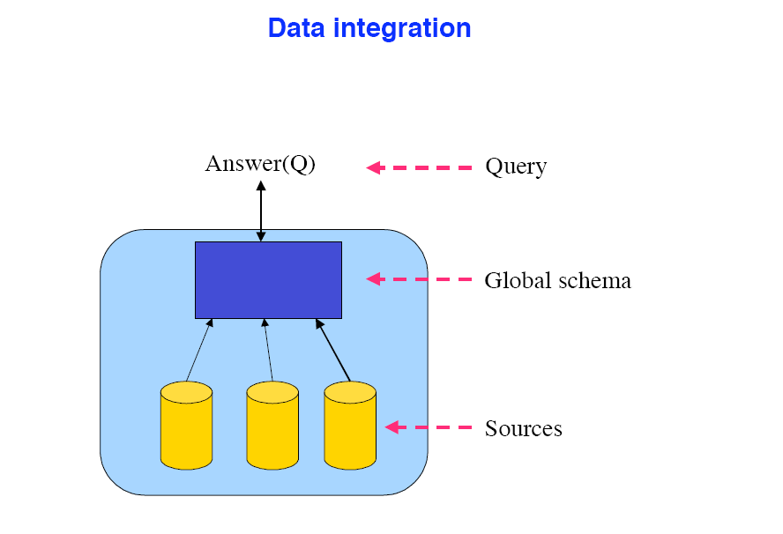
Mapping… what is this?

Slide 31
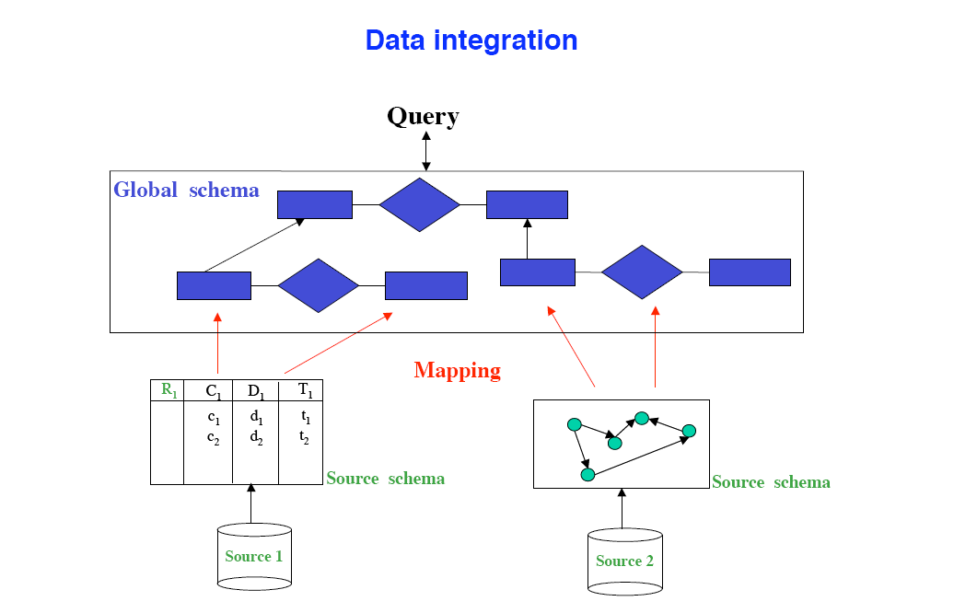
…

Slide 32
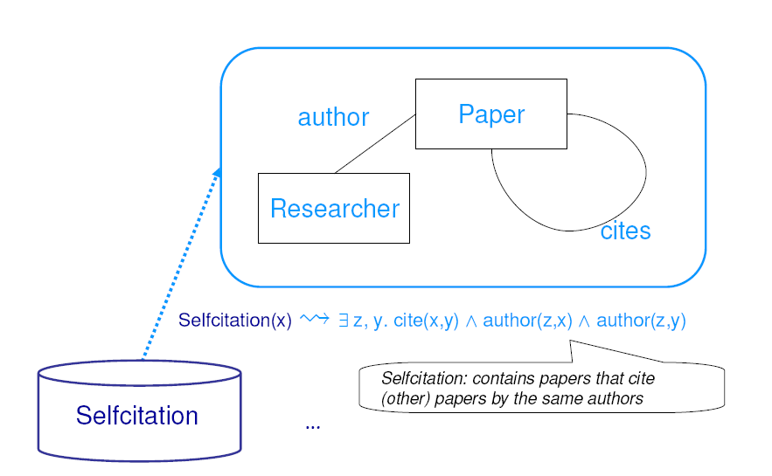
An example

Slide 33
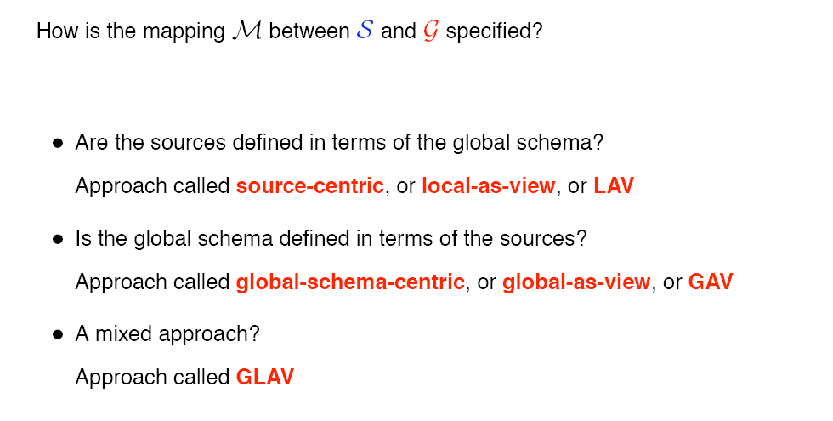
Mapping…how many?

Slide 34
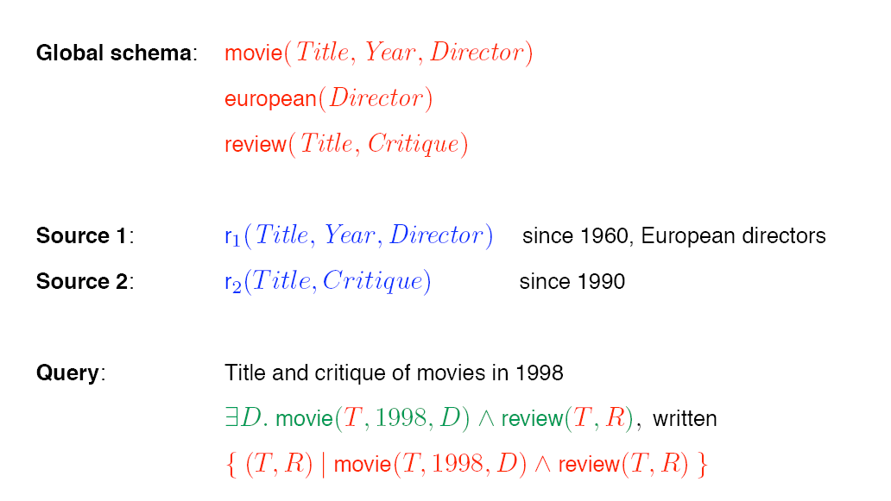
GAV vs LAV example

Slide 35
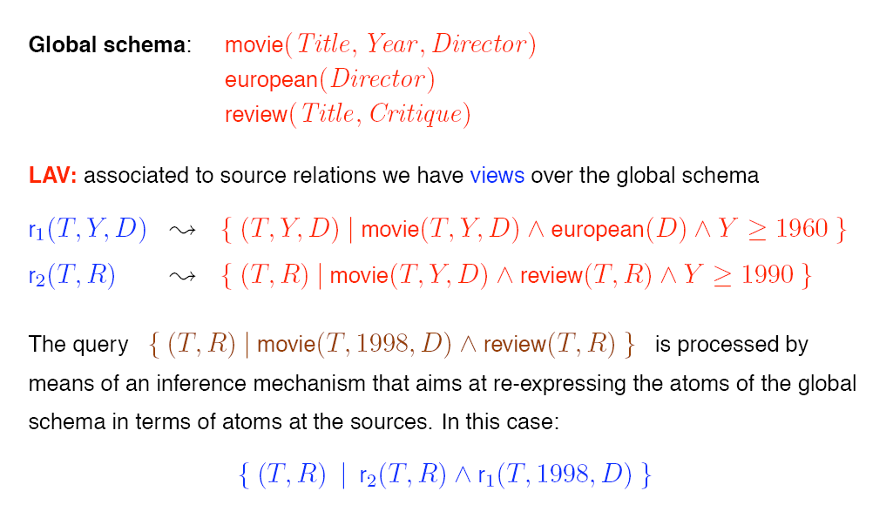
LAV example

Slide 36
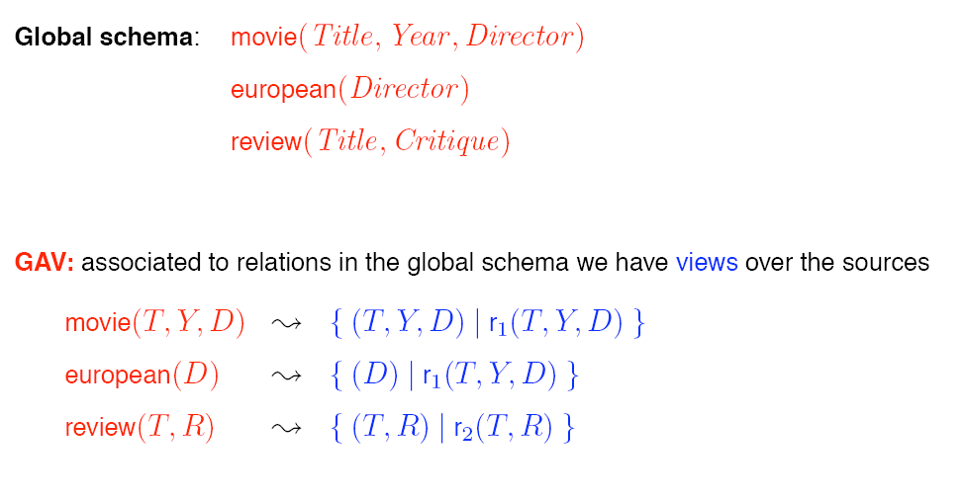
Gav example

Slide 37
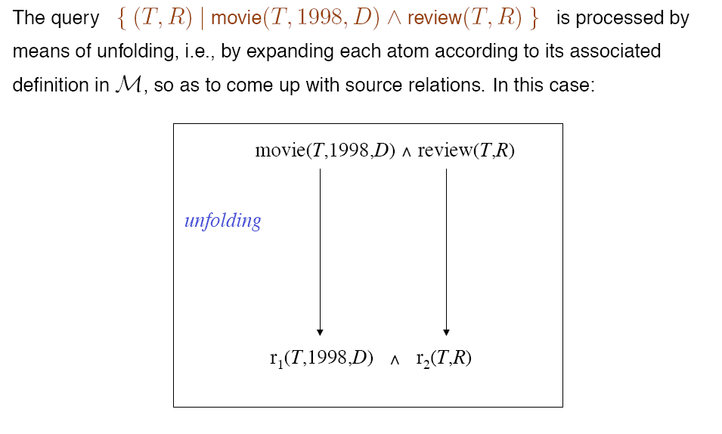
Example of query processing

Slide 38
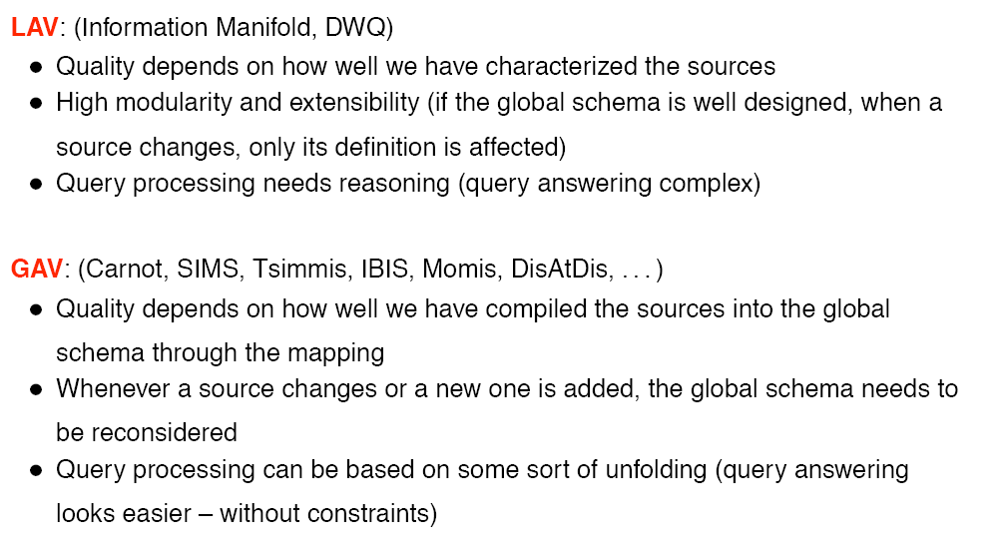
Gav & Lav: comparison

Slide 39
IMDb: mapping
A DL-Lite_{A} ontology with mappings is characterized by a triple
O_{m} =<T,M,DB> such that:
T is a DL-Lite_{A} TBox
DB is a relational database
M is a set of mapping assertion, partitioned into two sets, M_{t} and M_{a}
Where:
M_{t} is a set of so-called typing mapping assertions, each one of the form
φ→T_{i}
where φ is a query of arity 1 over DB denoting the projection of one relation over one of its columns, and
T_{i} is one of the DL-Lite_{A} data types;
M_{a} is a set of data-to-object mapping assertions (or simply mapping assertions), each one of the form
φ→ψ
where φ is an arbitrary SQL query of arity n>0 over DB, ψ is a conjunctive query over T of arity n’>0 without non distinguished variables, that possibly involves variable terms. A variable term is a term of the same form as the object terms introduced above, with the difference that variables appear as argument of the function. In other words, a variable terms has the form f(z), where f is a function symbol in Λ of arity m, and z denotes an m-tuple of variables.

Slide 40
Typing mapping assertion example
M_{t1} : SELECT id FROM ACTOR ⤳ xsd:int
M_{t2} : SELECT name FROM ACTOR ⤳ xsd:string
M_{t3}: SELECT surname FROM ACTOR ⤳ xsd:string
M_{t4}: SELECT sex FROM ACTOR ⤳ xsd:string
M_{t5}: SELECT actor FROM actor2movie ⤳ xsd:int

Slide 41
Data-to-object mapping assertions example
Λ(OBJECT VARIABLE TERMS)={actor(x)}
M_{m1}: SELECT ID,name,surname,sex
FROM ACTOR
ACTOR(actor(ID)), ID(actor(ID),ID),name(actor(ID),name),surname(actor(ID),surname),sex(actor(ID),sex)

Slide 42
Riferimenti
www.imdb.com
Dispense tratte dal corso di “seminario di ingegneria del software”
Diego Calvanese,Giuseppe De Giacomo, Domenico Lembo, Maurizio Lenzerini, Antonella Poggi, Riccardo Rosati. Linking Data to Ontologies: The Description Logic DL-Lite_{A} . In Proc. of the 2006 International Workshop on OWL: Experiences and directions (OWLED 2006).
Diego Calvanese,Giuseppe De Giacomo, Domenico Lembo, Maurizio Lenzerini, Antonella Poggi, Riccardo Rosati. MASTRO-I: Efficient integration of relational data through DL ontologies. In Proc. of the 2007 Description Logic Workshop (DL 2007).
Diego Calvanese,Giuseppe De Giacomo, Domenico Lembo, Maurizio Lenzerini, Antonella Poggi, Riccardo Rosati. Linking Data to Ontologies.

