Slide 1
Visibility based
Probabilistic Motion Planning
T. Siméon, J.P. Laumond, C. Nissoux,
Visibility based probabilistic roadmaps for motion planning
Advanced Robotics Journal, Vol. 14, N°6, 2000
J.P. Laumond, T Siméon,
Notes on visibility roadmaps and path planning
in Algorithmic and Computational Robotics: New Directions
B. Donald, K. Lynch, D. Rus Eds, A.K. Peters, 2001

Slide 2
Configuration Space
Any admissible motion for the 3D mechanical system appears a collision-free path for a point in the CSpace
Translating the continuous problem into a combinatorial one
Capturing the topology of CSfree with graphs

Slide 3
Configuration Space Topology and Small Time Controllability
Any steering method accounting for the small time controllability of the system induces the same topology

Slide 4
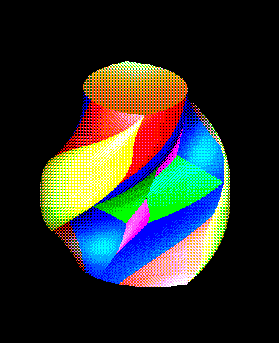
Configuration Space Topology and Small Time Controllability
Exemples:
    linear interpolation,
    Manhattan paths,
    Reeds and Shepp paths,
    flatness based methods
Euclidean Manhattan Reeds-Shepp

Slide 5
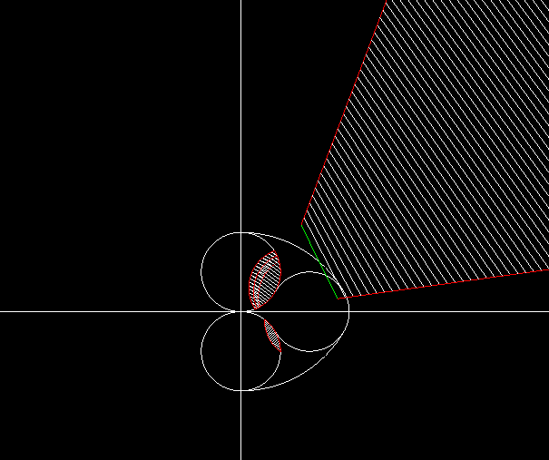
Same topology, different visibility sets
Euclidean
Manhattan like
Reeds-Shepp

Slide 6
Combinatorial topology (1)
Existence and robustness of finite coverage
Euclidean
Manhattan

Slide 7
Combinatorial topology (1)
Existence and robustness of finite coverage
No
Euclidean
Manhattan

Slide 8
Combinatorial topology (1)
Existence and robustness of finite coverage
No
Euclidean
Euclidean
Manhattan
Manhattan

Slide 9
Combinatorial topology (1)
Existence and robustness of finite coverage
Euclidean
Euclidean
Manhattan
Manhattan

Slide 10
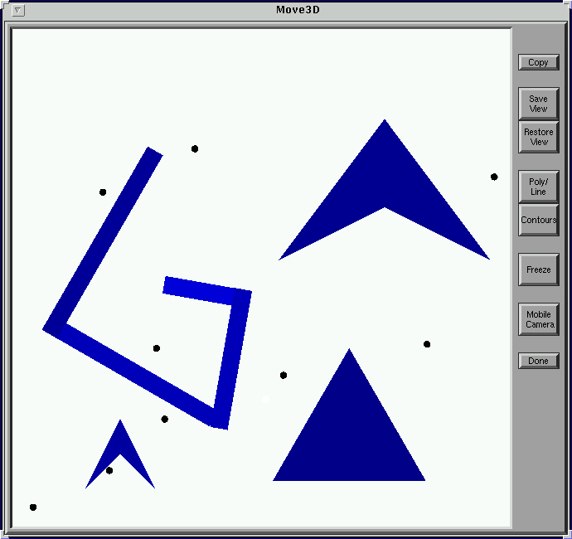
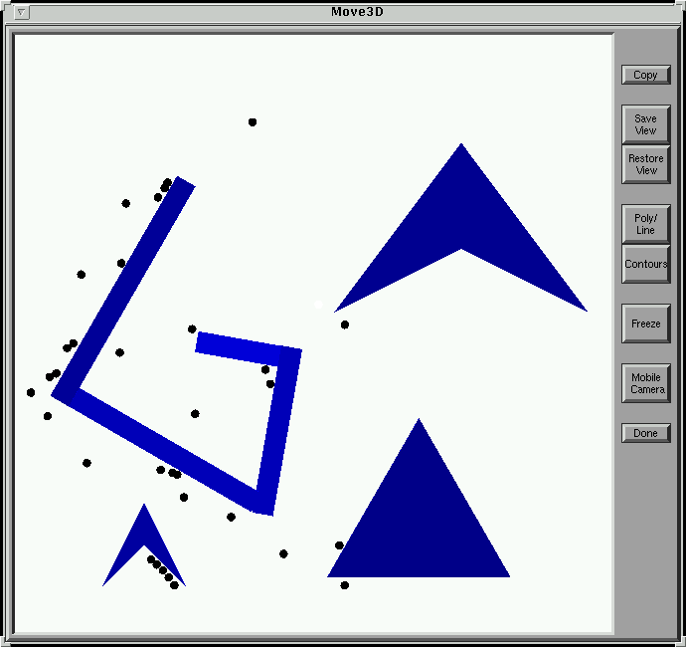
Combinatorial topology (2)
Optimal coverage (related to art gallery problem)
Euclidean
Manhattan

Slide 11
Combinatorial topology (2)
Optimal coverage: finite? bounded?
Euclidean and 2D polygonal obstacles: finite and bounded

Slide 12
Combinatorial topology (3)
Optimal coverage: finite? bounded?
Euclidean: finite and unbounded

Slide 13
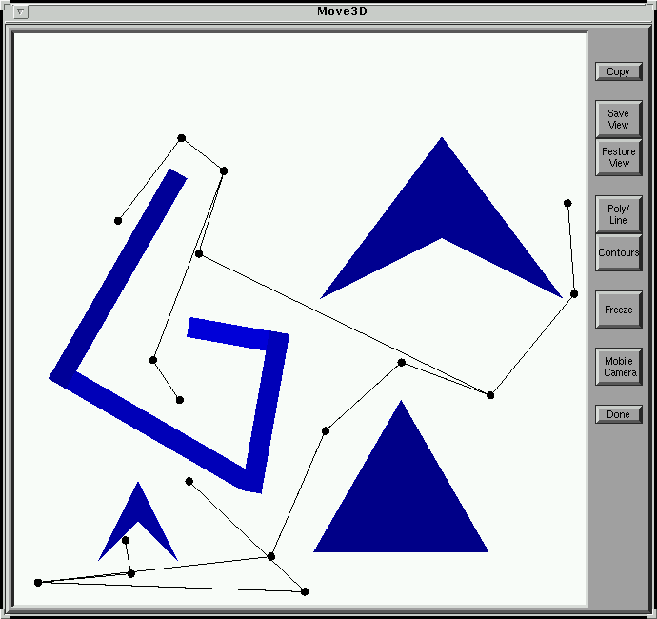
Combinatorial topology (4)
From (optimal) coverage to (visibility) roadmaps
Guards + Connectors

Slide 14
Computational challenge
No explicit knowledge of CS-obstacles
No explicit knowledge of visible (reachable) sets

Slide 15
Computational challenge
Probabilistic method ingredients:
  A collision checker
  A steering method
Two type methods:
  Learning CS topology by sampling
  Answering single query by diffusion

Slide 16
Computational challenge
Random sampling

Slide 17
Computational challenge
Random diffusion

Slide 18
Visibily based sampling
Algorithm:
  Generate guards and connectors randomly
  Stop after #try failures

Slide 19
Visibily based sampling

Slide 20
Visibily based sampling

Slide 21
Visibily based sampling

Slide 22
Visibily based sampling

Slide 23
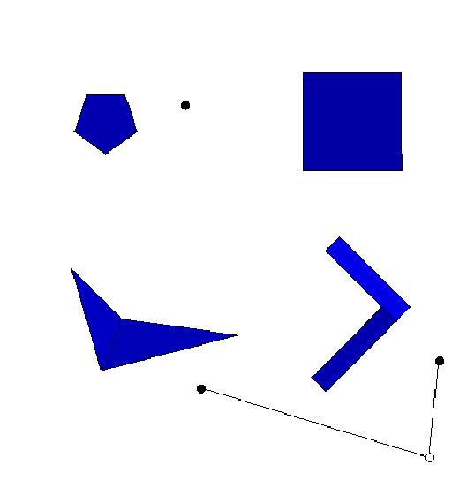
Visibily based sampling
Algorithm:
  Generate guards and connectors randomly
  Stop after #try failures (#try=10)

Slide 24
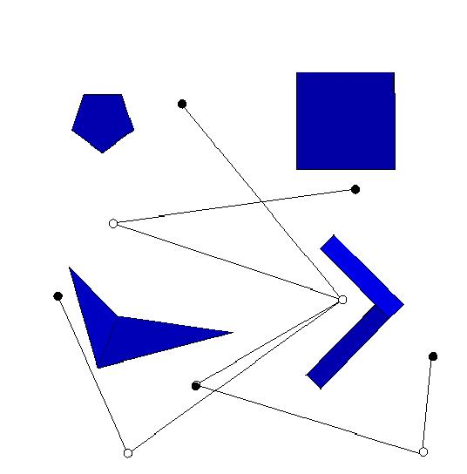
Visibily based sampling
Algorithm:
  Generate guards and connectors randomly
  Stop after #try failures (#try=100)

Slide 25

Visibily based sampling
Algorithm:
  Generate guards and connectors randomly
  Stop after #try failures (#try=200)

Slide 26
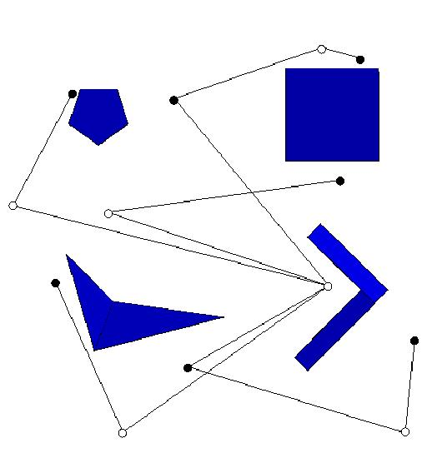
Visibily based sampling
Algorithm:
  Generate guards and connectors randomly
  Stop after #try failures (#try=500)

Slide 27
Visibily based sampling
Algorithm:
  Generate guards and connectors randomly
  Stop after #try failures (#try=1000)

Slide 28
Visibily based sampling
Algorithm:
  Generate guards and connectors randomly
  Stop after #try failures (#try=10000)

Slide 29
Visibily based sampling
Algorithm:
  Generate guards and connectors randomly
  Stop after #try failures (#try=1000000000!)

Slide 30
Visibily based sampling
Algorithm:
  Generate guards and connectors randomly
  Stop after #try failure
Theorems:
  The estimated percentage of non-covered free-space is #try⁻¹
  Probability to find an existing path increases as an exponential function of time

Slide 31
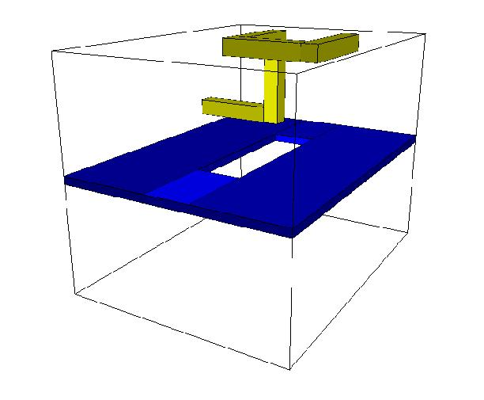
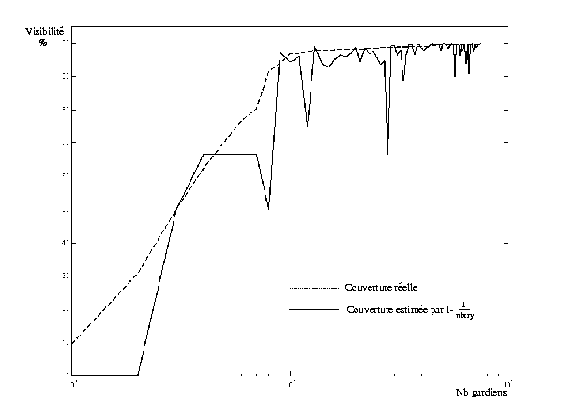
Visibily based sampling
Possible online estimation of #try
coverage %
100
# guards

Slide 32
Visibily based sampling
Real time demonstrations

