Slide 1
Motion Planning
Geometrical Formulation of the Piano Mover Problem

Slide 2
Configuration Space
Environment made of bodies: compact and connected domains of the Euclidean space
Body placement: translation-rotation composition
Placement Space P
Obstacles: finite number of fixed bodies
Subspace E of the Euclidean Space
Robot: (R,A) with R=(R₁, R₂, … R_{m}) and P ^{m} A
A: valid placements defined by holonomic links
Configuration: minimal parameterization of A
For c in CS, c(R) is the domain of the Euclidean space occupied by R at configuration c.

Slide 3
Configuration Space Topology
Topology on CS: induced by Hausdorff metric in Euclidean space
d(c,c’) = d_{Hausdorff}(c(R),c’(R))
Path: continuous function from [0,1] to CS

Slide 4
Configuration
Admissible: c(R) int(E) =
Free: c(R) E =
Contact: c(R) int(E) = and c(R) E ≠
Collision: c(R) int(E) ≠

Slide 5
Configuration
Admissible: c(R) int(E) =
Free: c(R) E =
Contact: c(R) int(E) = and c(R) E ≠
Collision: c(R) int(E) ≠

Slide 6
Configuration
Admissible: c(R) int(E) =
Free: c(R) E =
Contact: c(R) int(E) = and c(R) E ≠
Collision: c(R) int(E) ≠
Admissible Free Collision Contact

Slide 7
Configuration
int (Admissible) = Free
Admissible ≠ clos (int (Admissible) )
Admissible ≠ clos (Free)
Numerical algorithms work in Free
Admissible Free Collision Contact

Slide 8
Path search
Any admissible motion for the 3D mechanical system appears a collision-free path for a point in the CS_{Admissible}
How to translate the continuous problem into a combinatorial one?

Slide 9
Cell Decomposition
Cell: domain of CS_{Admissible}
Cells C₁ and C₂ are adjacent if:
clos (C₁ ) C₂ clos (C₂ ) C₁ ≠
Connected components of topological space
=
Connected components of the cell graph

Slide 10
Cell Decomposition Ingredients
Cell decomposition algorithm
Algorithm to localize a point within a cell
Algorithm to move within a single cell
A path search algorithm within a graph
Examples:
Sweeping line algorithm to decompose polygonal environments into trapezoids
Cylindrical algebraic decomposition

Slide 11
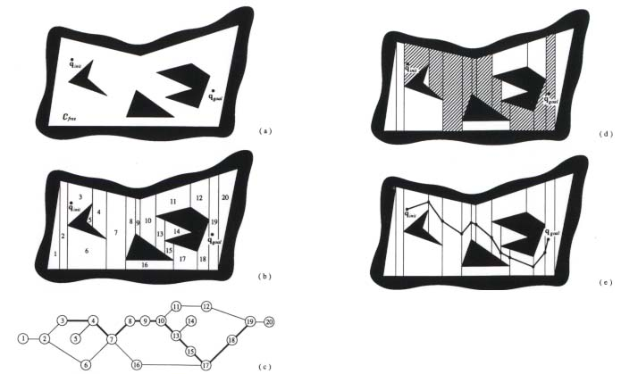
Cell Decomposition
Sweeping line algorithm to decompose polygonal environments into trapezoids

Slide 12
Retraction
Almost everywhere continuous function from space S to sub-space retract (S) such that:
x and retract (x) belong to the same connected component of S
Each connected component of S contains exactly one connected component of retract (S)
Connected components of topological space
=
Connected components of the retracted space

Slide 13
Retraction
Apply retraction recursively to decrease the dimension of the topological space
Examples:
Voronoï diagrams
Visibility graphs
Retraction on the border of the obstacles (algebraic topology issues)
Probabilistic roadmaps

Slide 14
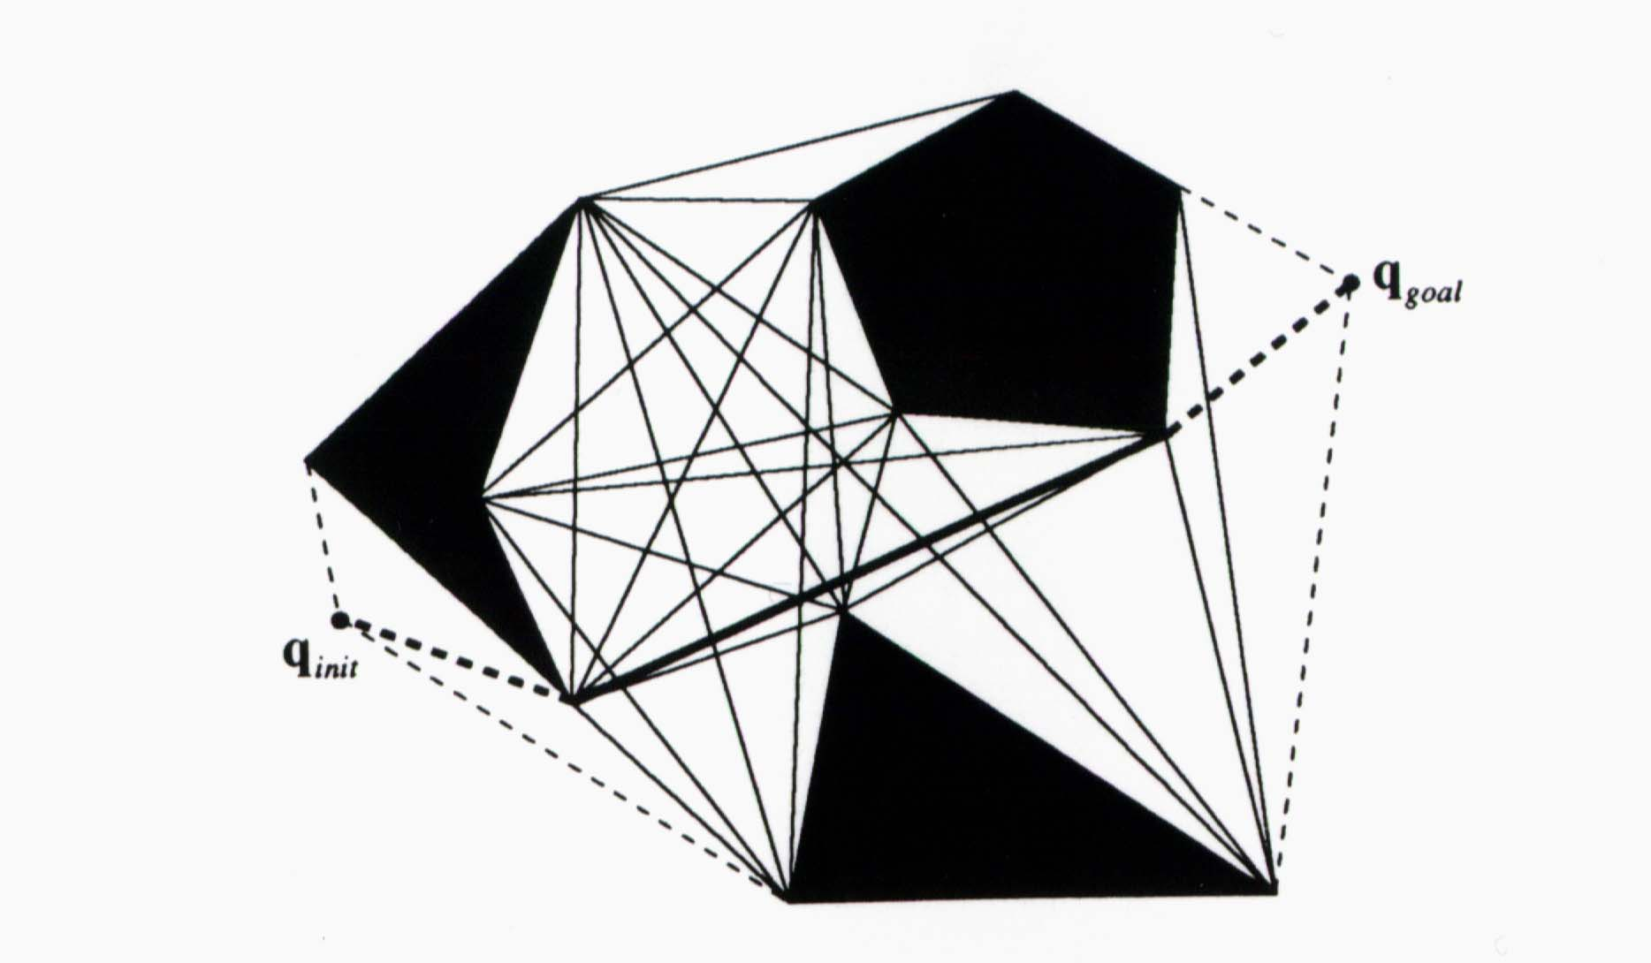
Retraction
Visibility Graph

Slide 15
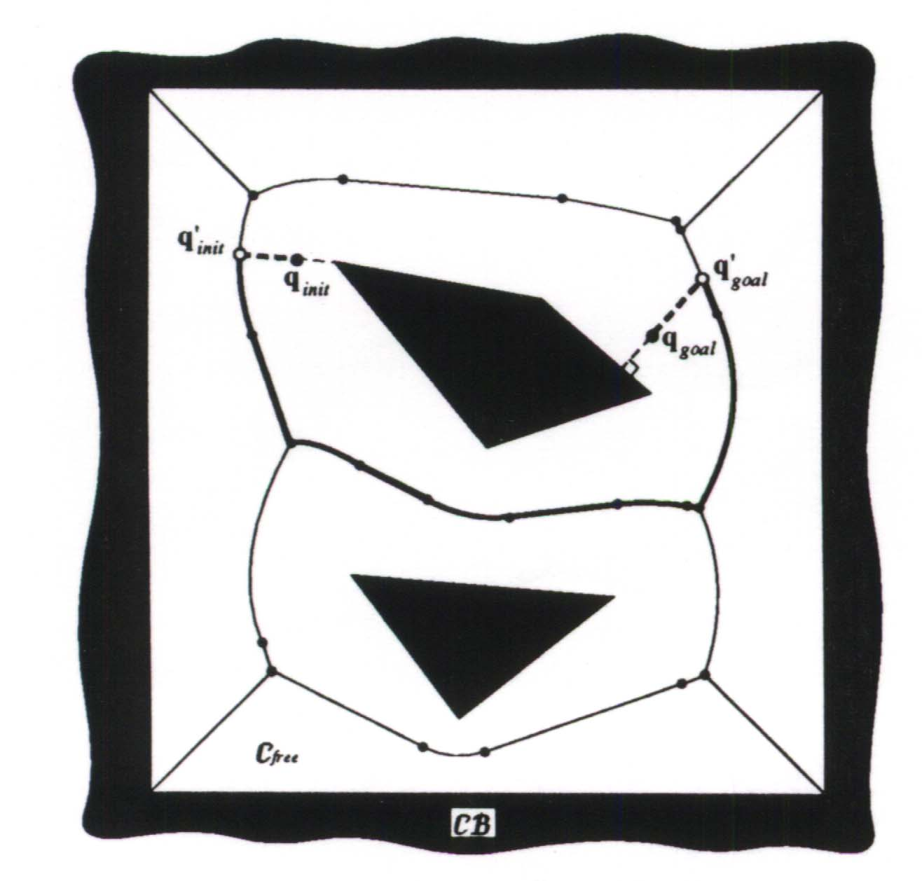
Retraction
Voronoï Diagram

