Slide 1
Manipulation Planning
A Geometrical Formulation

Slide 2
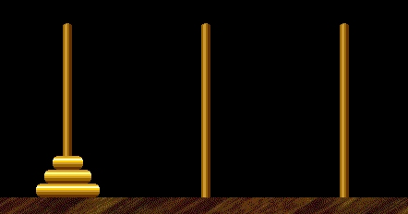
Manipulation Planning
Hanoï Tower Problem

Slide 3
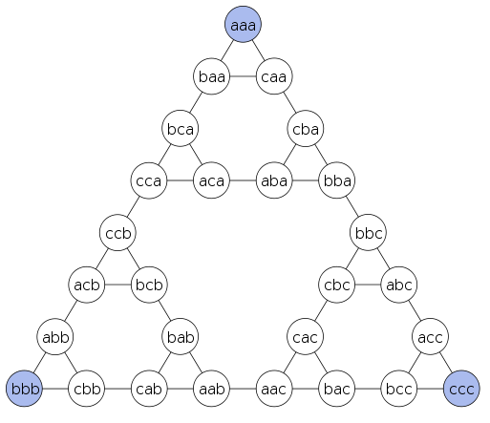
Manipulation Planning
Hanoï Tower Problem: a “pure” combinatorial problem
Finite state space

Slide 4
Manipulation Planning
A disk manipulating another disk

Slide 5
Manipulation Planning
A disk manipulating another disk
The state space is no more finite!

Slide 6
Manipulation Space
Any solution appears a collision-free path in the composite space (CS^{Robot} CS^{Object} )_{Admissible}
However: any path in (CS^{Robot} CS^{Object} )_{Admissible} is not necessarily a manipulation path

Slide 7
Manipulation Space
Any solution appears a collision-free path in the composite space (CS^{Robot} CS^{Object} )_{Admissible}
Any solution appears a collision-free path in the composite space (CS^{Robot} CS^{Object} )_{Admissible}
What is the topological structure of the manipulation space?
How to translate the continuous problem into a combinatorial one?

Slide 8
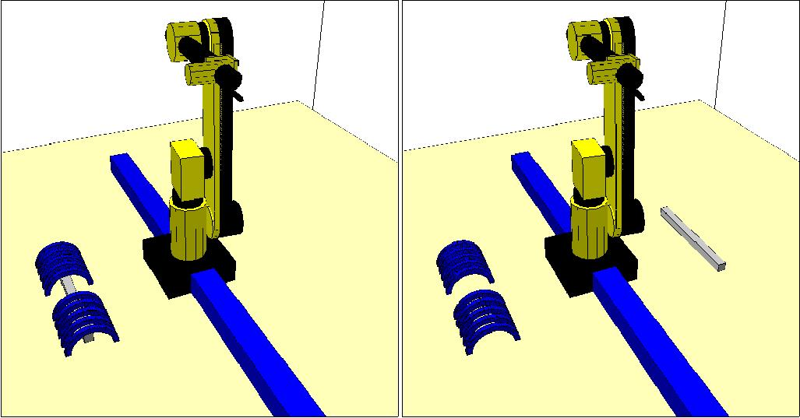
A work example

Slide 9
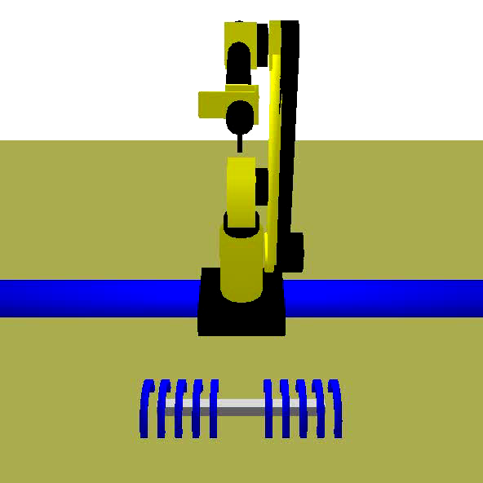
A work example

Slide 10
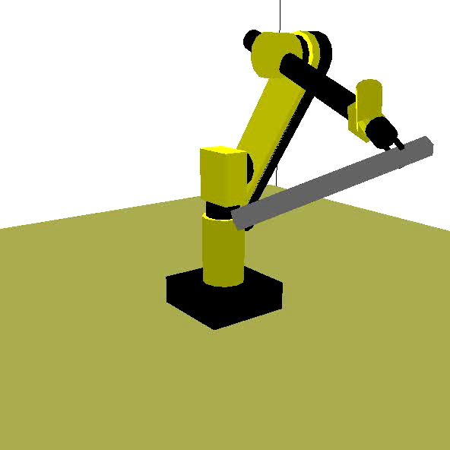
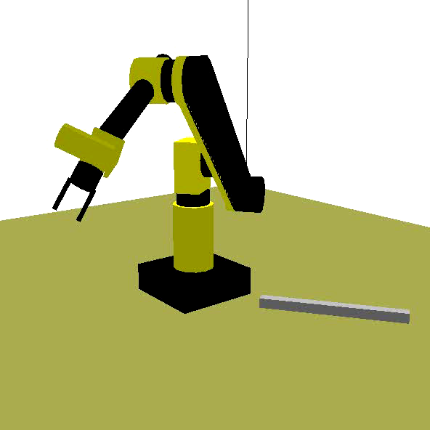
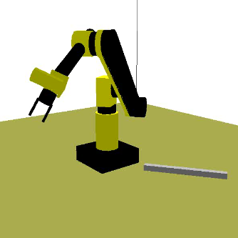
Allowed configurations
Grasp
Placement
Not allowed

Slide 11
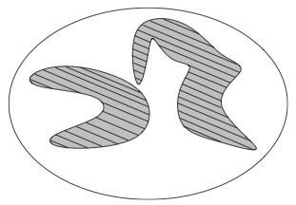
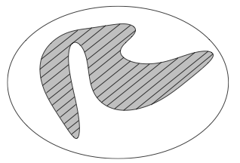
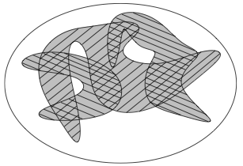
Allowed configurations
Grasp Space GS
Placement Space PS
Manipulation Space
GS PS

Slide 12
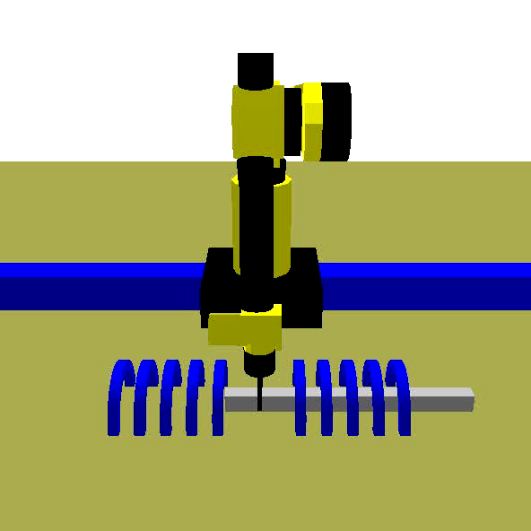
Allowed paths
Transit paths
Transfer paths
Not allowed paths

Slide 13
Allowed paths induce foliations in GS PS
Transit paths
Transfer paths
Not allowed paths

Slide 14
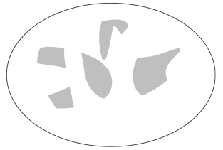
Manipulation space topology
GS PS
GS PS

Slide 15
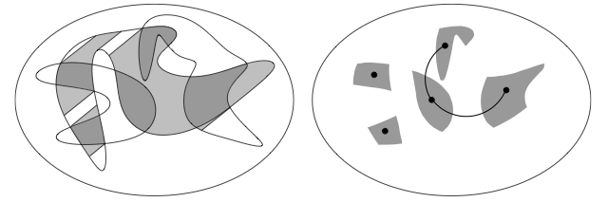
Manipulation space topology
GS PS
GS PS
Adjacency by transfer paths

Slide 16
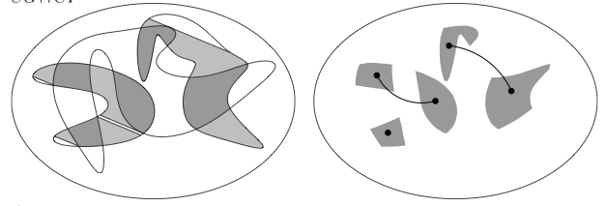
Manipulation space topology
GS PS
GS PS
Adjacency by transit paths

Slide 17
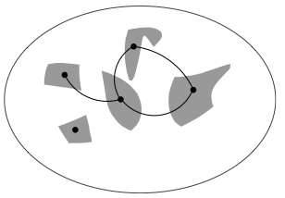
Manipulation space graph

Slide 18
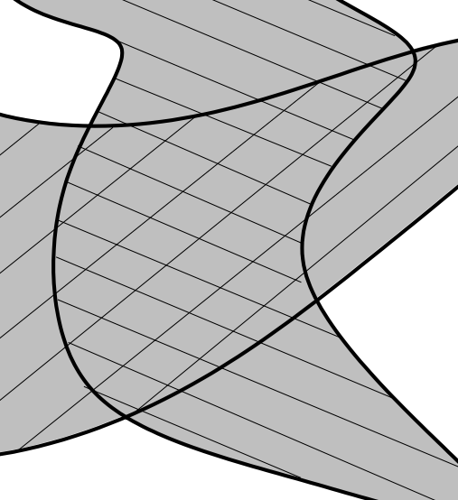
Topological property in GS PS
Theorem: When two foliations intersect, any path can be
approximated by paths along both foliations.

Slide 19
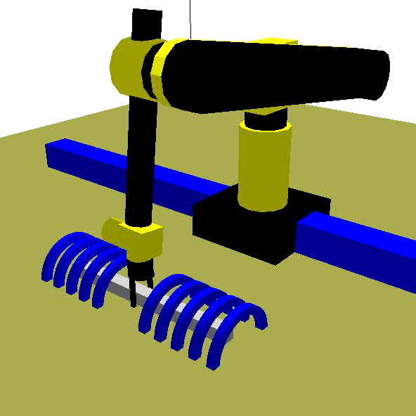
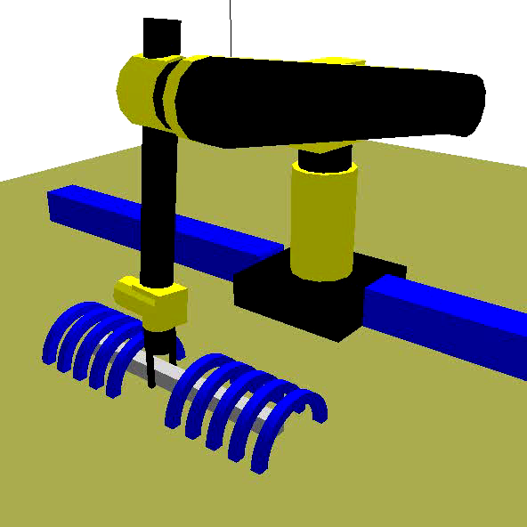
Topological property in GS PS
Corollary: Paths in GS∩PS can be approximated by finite sequences
of transit and transfer paths

Slide 20
Manipulation space graph
Corollary: A manipulation path exists iff both starting and goal configurations can be retracted on two connected nodes of the manipulation graph.

Slide 21
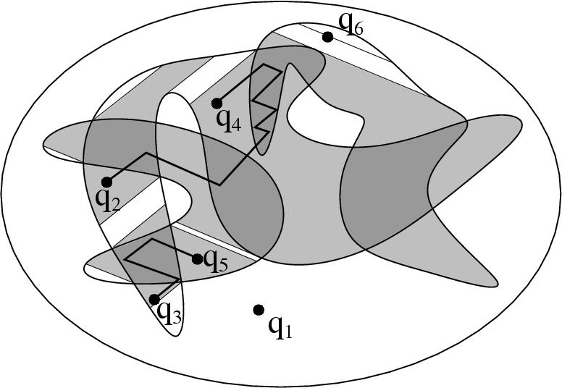
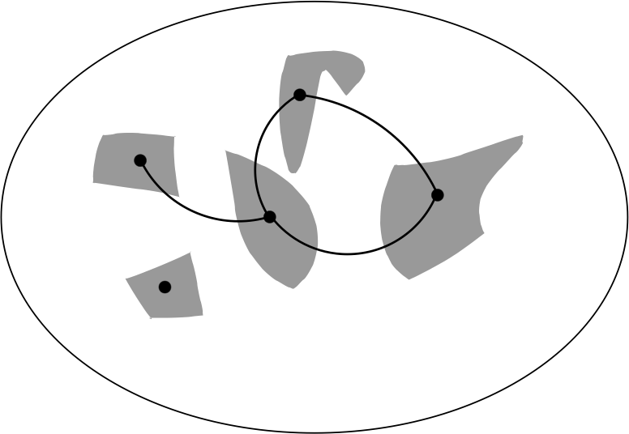
Manipulation space graph
Proof

Slide 22
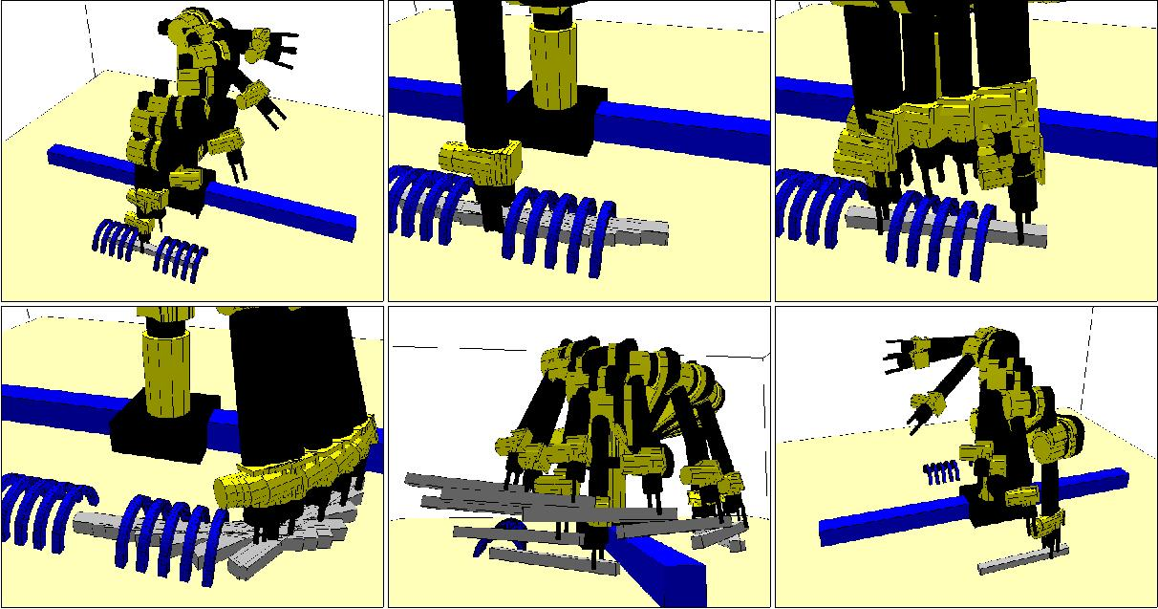
Manipulation space
Transit Path
GS∩PS Path
Transit Path
GS∩PS Path
Transfer Path
Transit Path

Slide 23
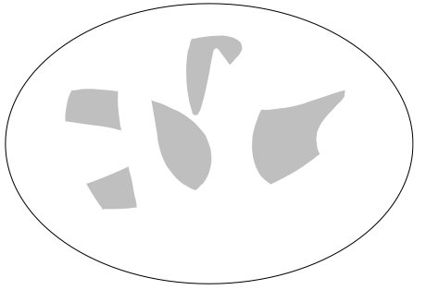
Manipulation algorithms
Capturing the topology
of GS PS
Compute adjacency

Slide 24
The case of finite grasps and placements
Graph search

Slide 25
The case of two disks
Capturing the topology of GS PS: projection of the cell decomposition of the composite space
Adjacency by retraction
B. Dacre Wright, J.P. Laumond, R. Alami
Motion planning for a robot and a movable object amidst polygonal obstacles.
IEEE International Conference on Robotics and Automation, Nice,1992.
J. Schwartz, M. Sharir
On the Piano Mover III
Int. Journal on Robotics Research, Vol. 2 (3), 1983

Slide 26
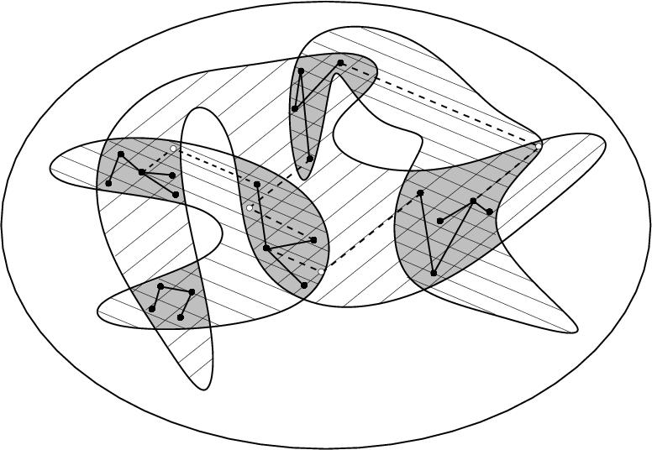
The general case
Capturing the topology of GS PS
Compute adjacency

Slide 27
The general case
Capturing the topology of GS PS:
Path planning for closed chain systems
Compute adjacency
Inverse kinematics

Slide 28
The general case: probabilistic algorithms
T. Siméon, J.P. Laumond, J. Cortes, A. Sahbani
Manipulation planning with probabilistic roadmaps
Int. Journal on Robotics Research, Vol. 23, N° 7-8, 2004.
J. Cortès, T. Siméon, J.P. Laumond
A random loop generator for planning motions of closed chains with PRM methods
IEEE Int. Conference on Robotics and Automation, Nice, 2002.

Slide 30
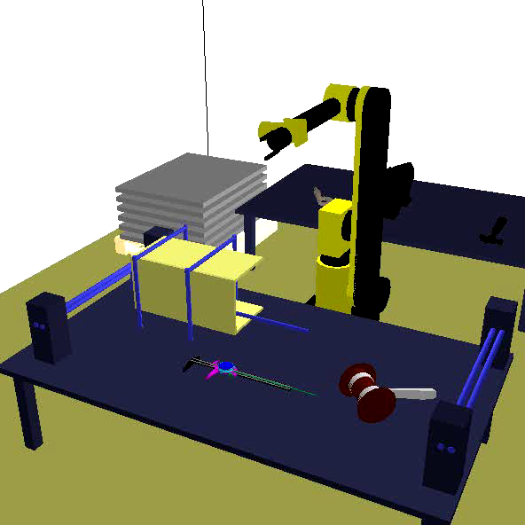

Slide 31
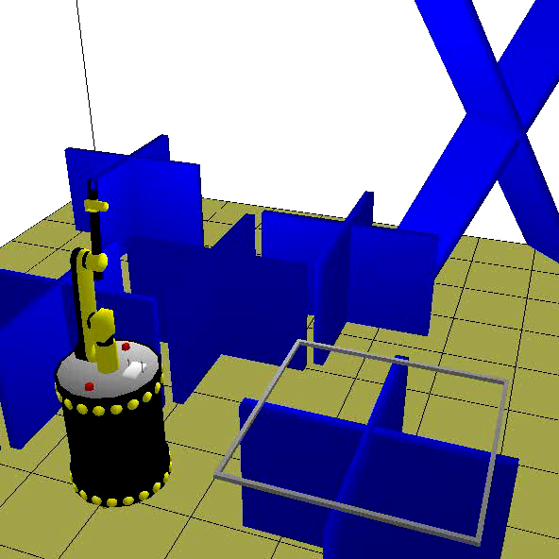

Slide 32
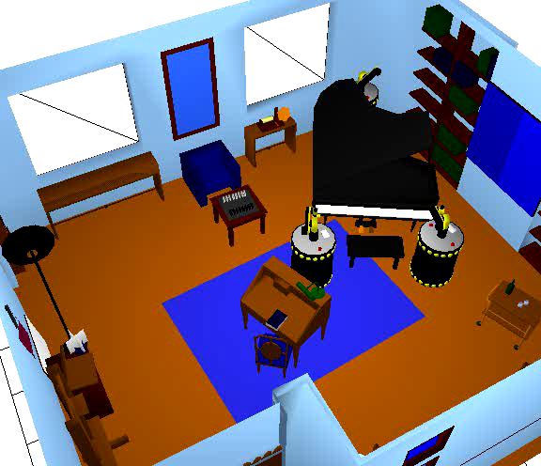
J. Cortès, T. Siméon, J.P. Laumond
A random loop generator for planning motions of closed chains with PRM methods
IEEE Int. Conference on Robotics and Automation, Nice, 2002.

Slide 33
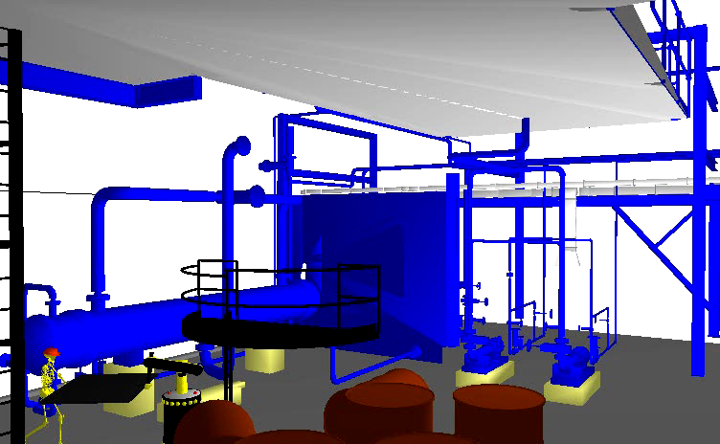
C. Esteves, G. Arechavaleta, J. Pettré, J.P. Laumond
Animation planning for virtual mannequins cooperation
ACM Trans. on Graphics, Vol. 25 (2), 2006.

Slide 34
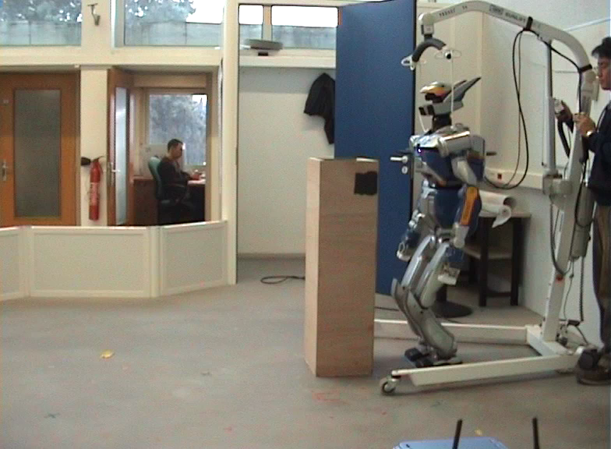
E. Yoshida, M. Poirier, J.P. Laumond, O. Kanoun, F. Lamiraux, R. Alami, K. Yokoi
Pivoting based manipulation by a humanoid robot
Autonomous Robots, Vol. 28 (1), 2010.

Slide 35
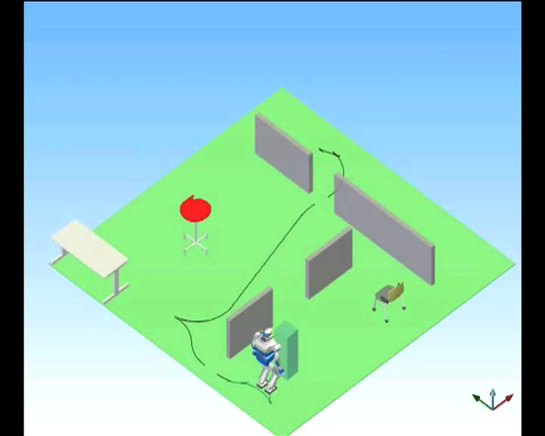
E. Yoshida, M. Poirier, J.-P. Laumond, O. Kanoun, F. Lamiraux, R. Alami, K. Yokoi
Regrasp Planning for Pivoting Manipulation by a Humanoid Robot
IEEE International Conference on Robotics and Automation, 2009.

