Slide 1
Anthropomorphic motion planning
J. Pettré, J.P. Laumond,
A motion capture based control-space approach for walking mannequins
Computer Animation and Virtual Worlds, Vol. 16, 2006.
C. Esteves, G. Arechavaleta, J. Pettré, J.P. Laumond,
Animation planning for virtual mannequins cooperation
ACM Trans. on Graphics, Vol. 25, N°2, 2006.
O. Kanoun, J.P. Laumond, E. Yoshida,
Planning foot placements for a humanoid robot : a problem of inverse kinematics
International Journal of Robotics Research, Vol. 30, N°4, 2011.
M. Sreenivasa, P. Souères, J.P. Laumond,
On using human movement invariants to generate target-driven anthropomorphic locomotion,
IEEE/RAS-EMBS International Conference on Biomedical Robotics and Biomechatronics (BioRob), 2010.

Slide 2
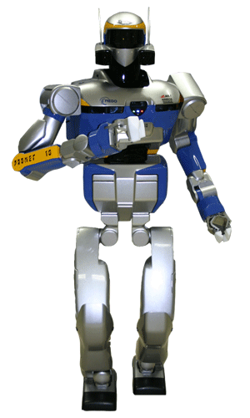

Anthropomorphic systems
Human body:
A highly redundant system
Locomotion: a underactuated system
Challenge: Whole body motion understanding

Slide 3
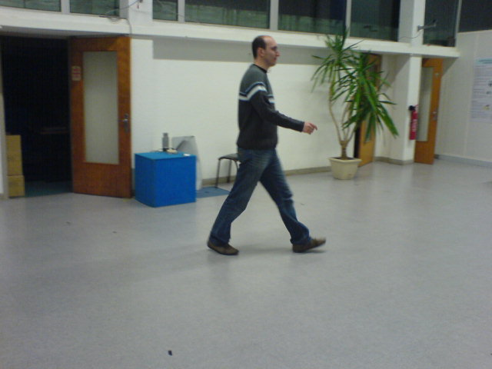
Imitation-based locomotion
A velocity control space approach
ω
v

Slide 4
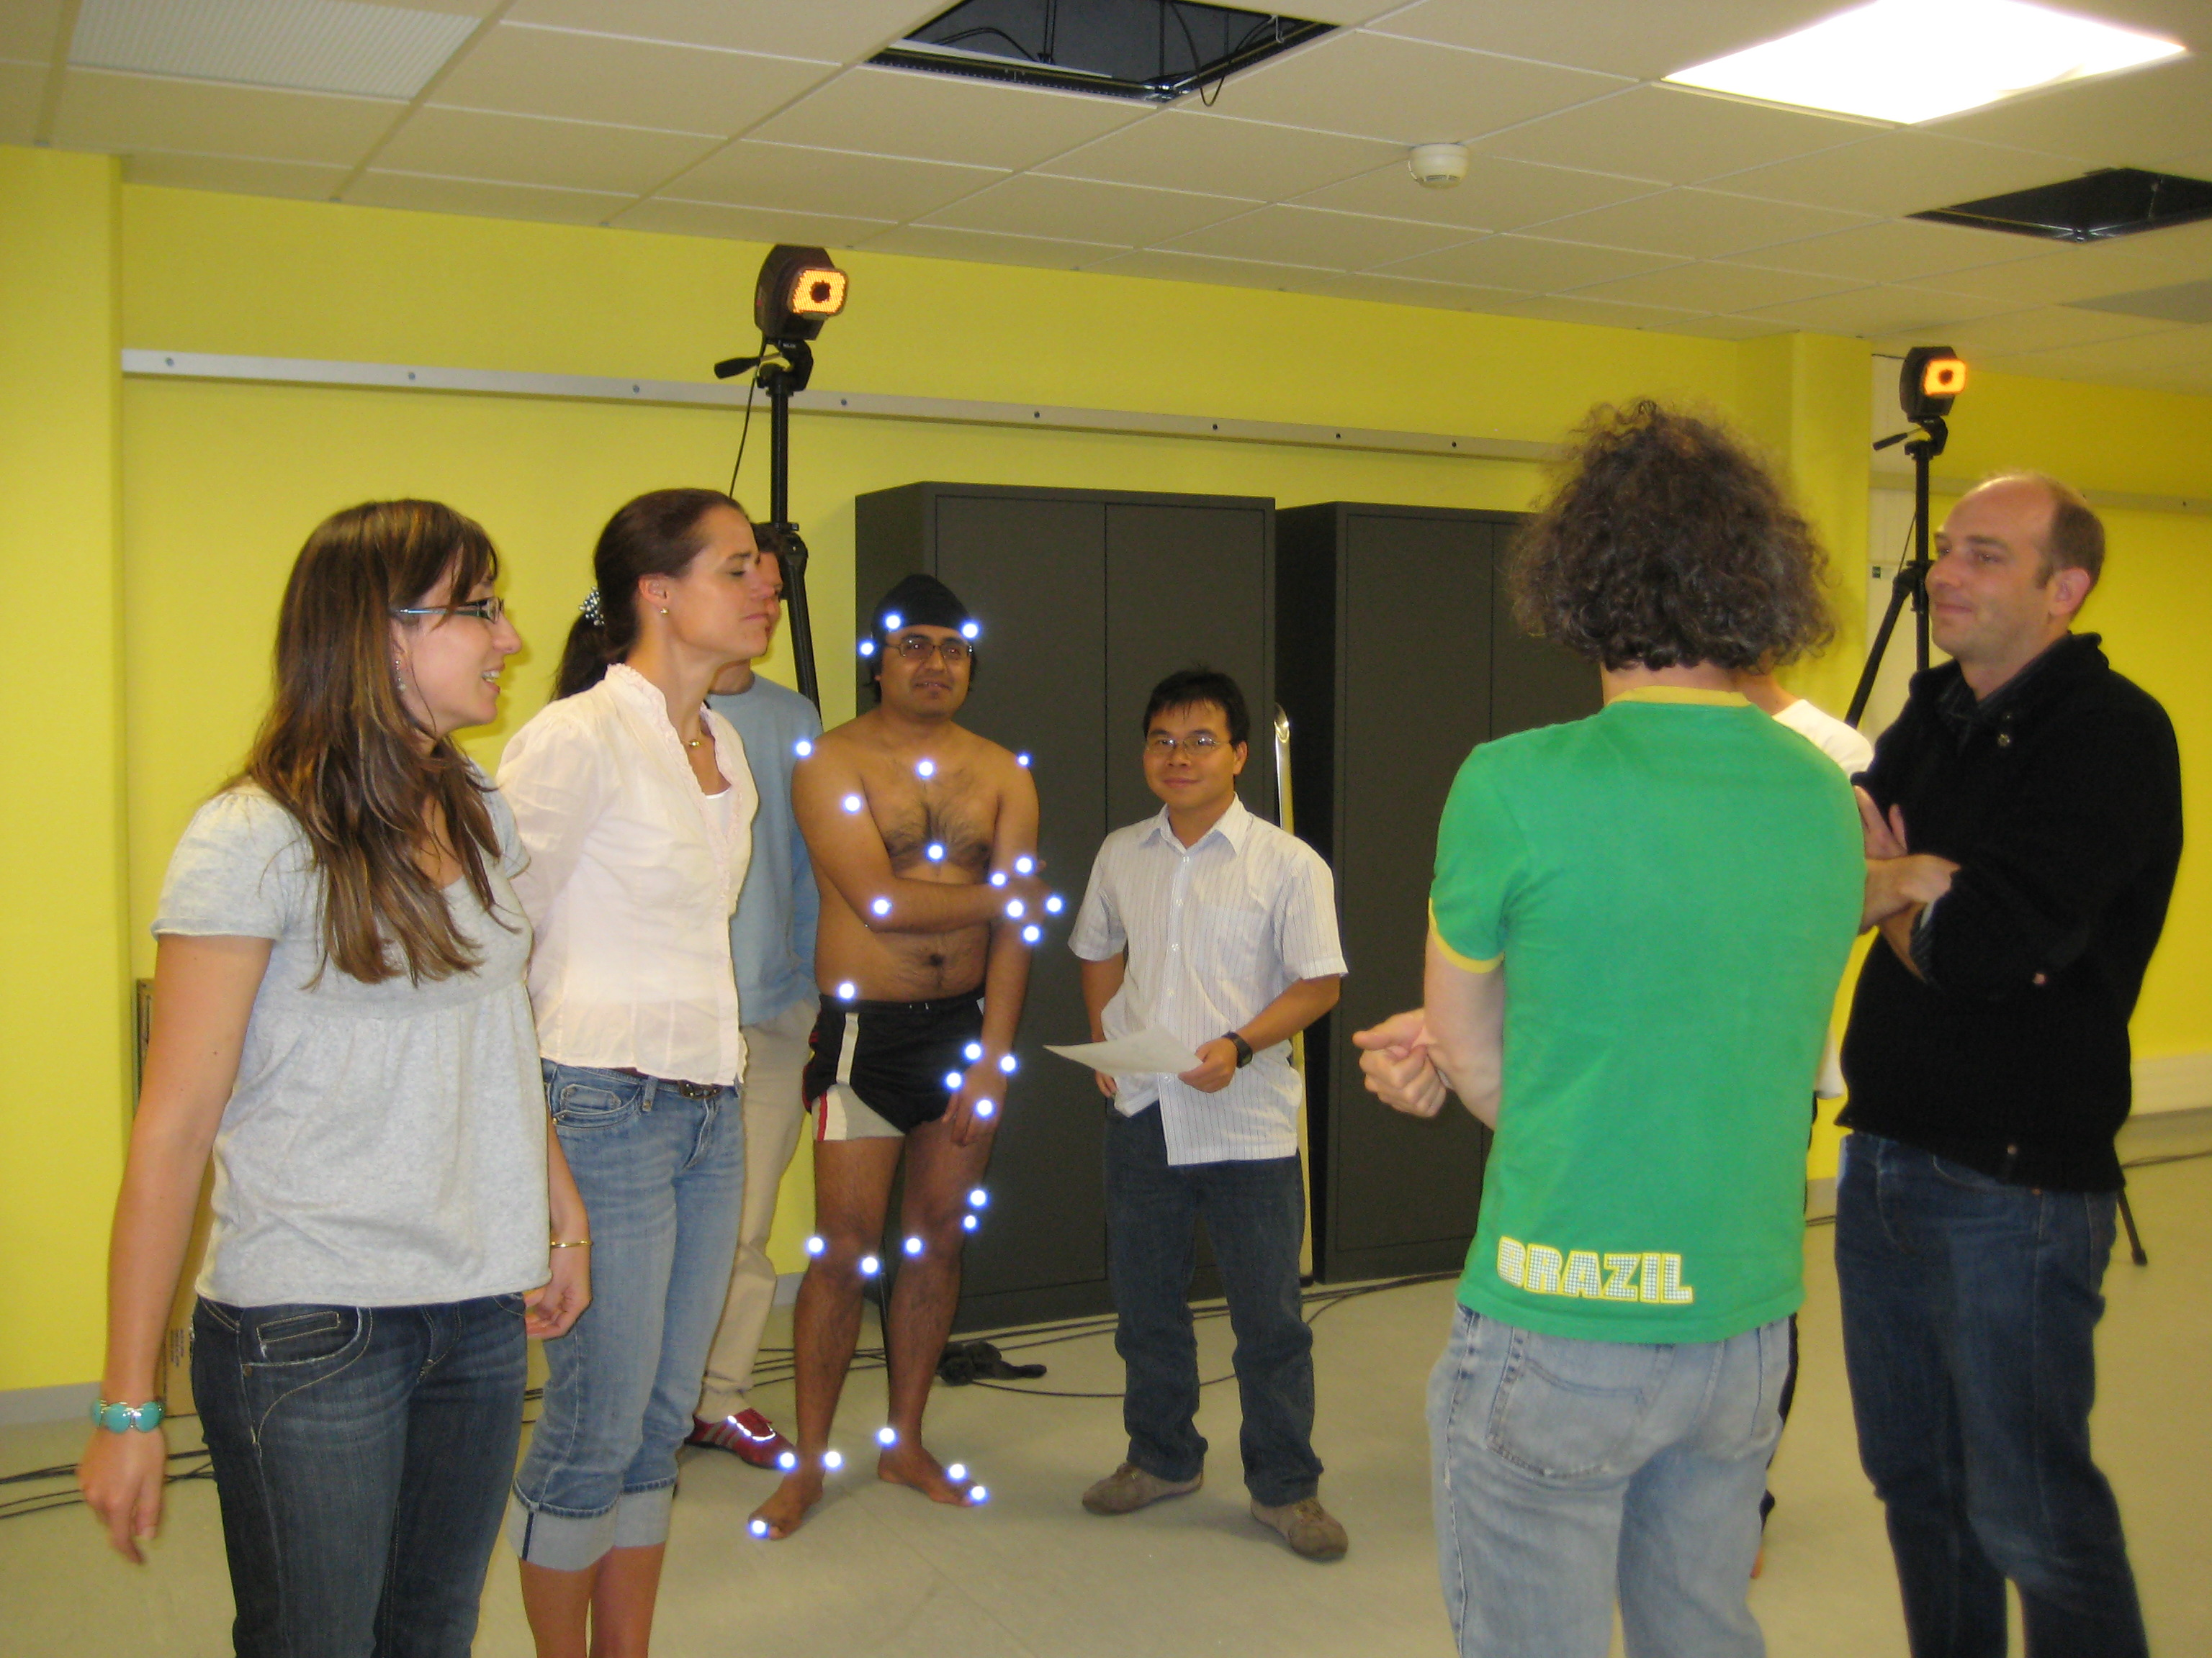
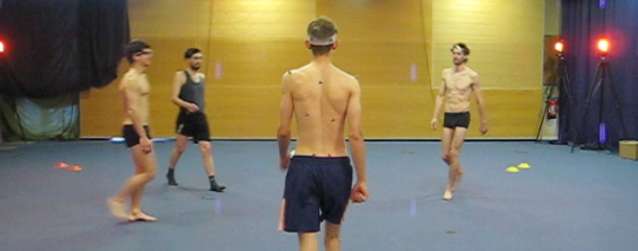
Imitation-based locomotion
A velocity control space approach
Imitation with motion capture

Slide 5
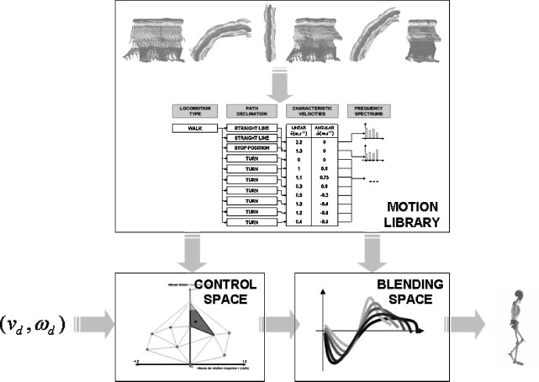
Imitation-based locomotion
A velocity control space approach
Analyzis of motion capture in the joint space

Slide 6
Imitation-based locomotion
A velocity control space approach
[video]

Slide 7
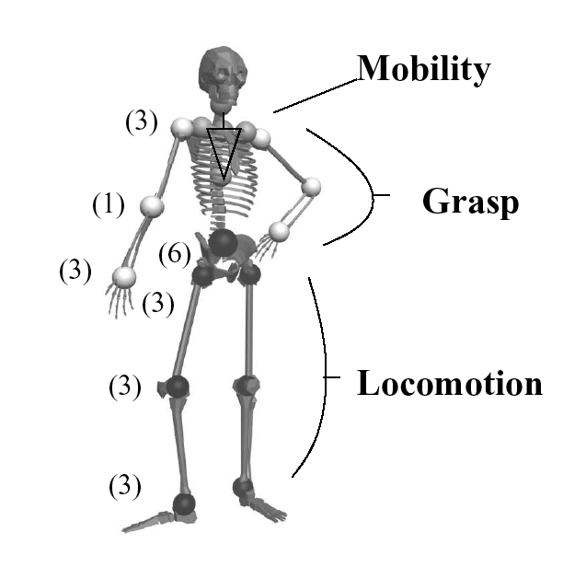
Motion planning
Separate manipulation and locomotion

Slide 8
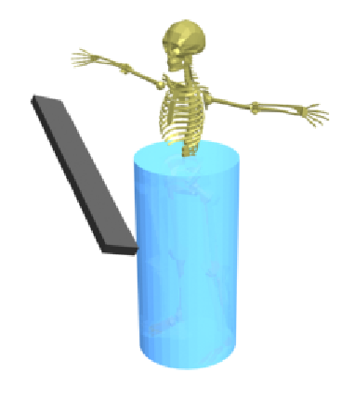
Motion planning
Object motion: 6 dof
Locomotion in the plane:
3 dimensions
A 9-dimensional « piano mover » problem

Slide 9
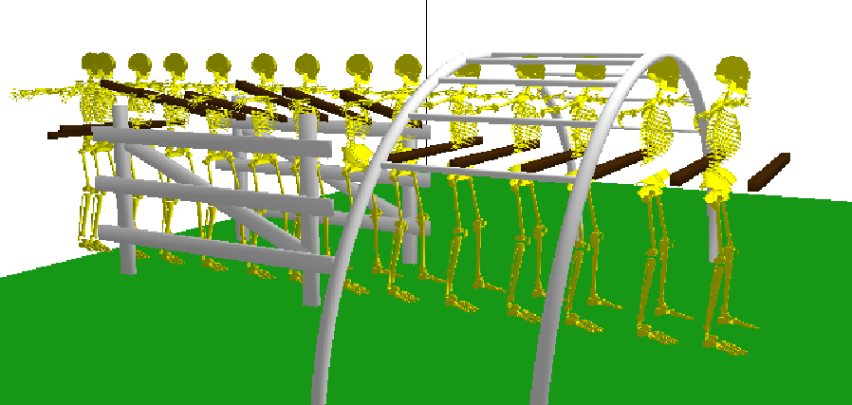
Motion planning
Step 1: Plan a collision-free path for « cylinder + object »

Slide 10
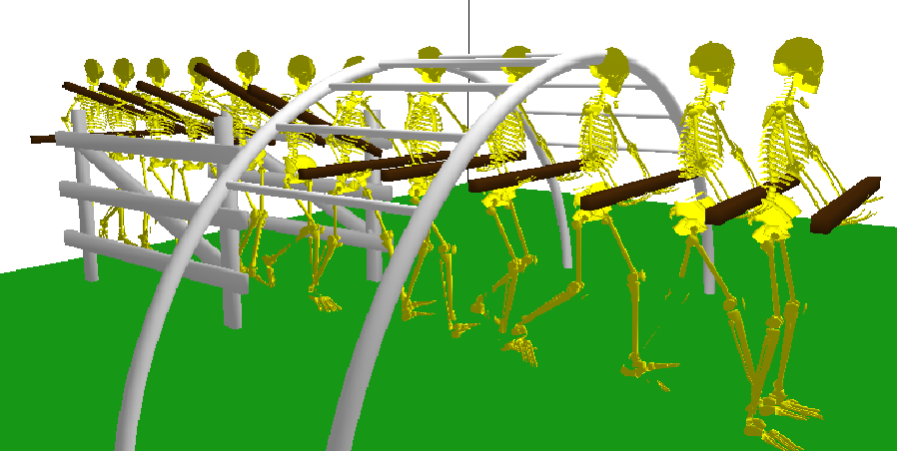
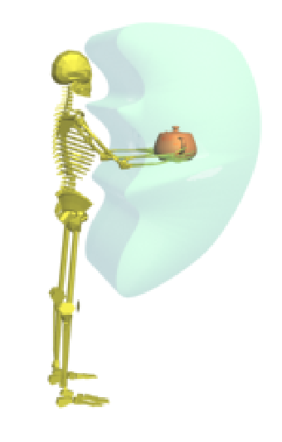
Motion planning
Step 2: Animate
locomotion dofs with locomotion controler
manipulation dofs with inverse kinematics

Slide 11
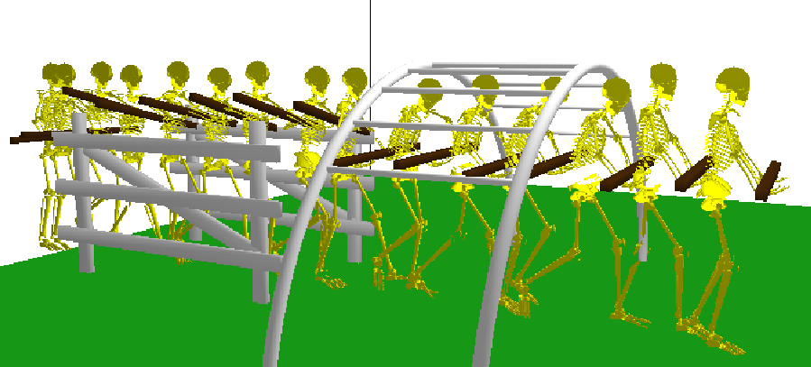
Motion planning
Step 3: Remove residual collision with mobility dofs

Slide 12
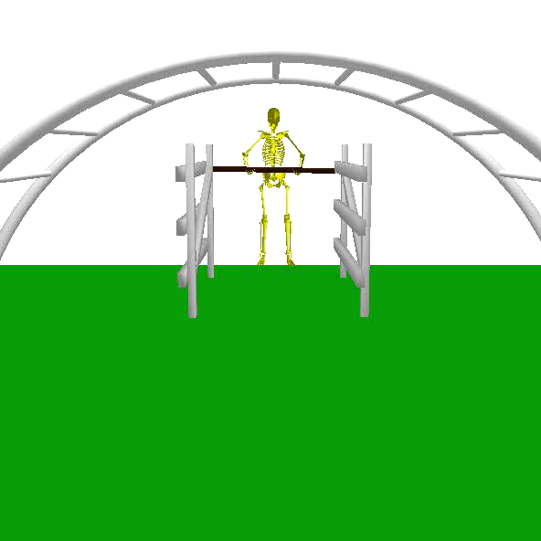
Motion planning

Slide 13
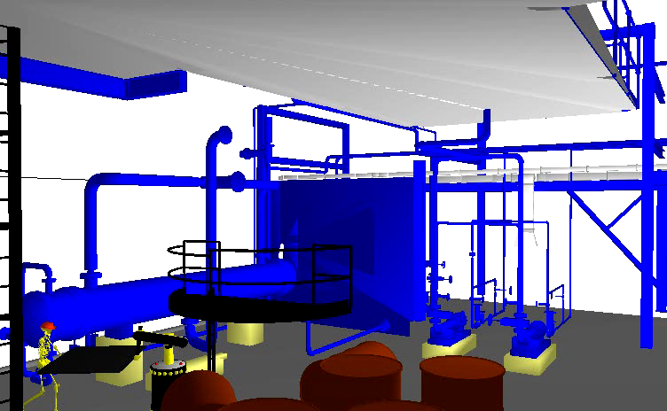
Motion planning

Slide 14
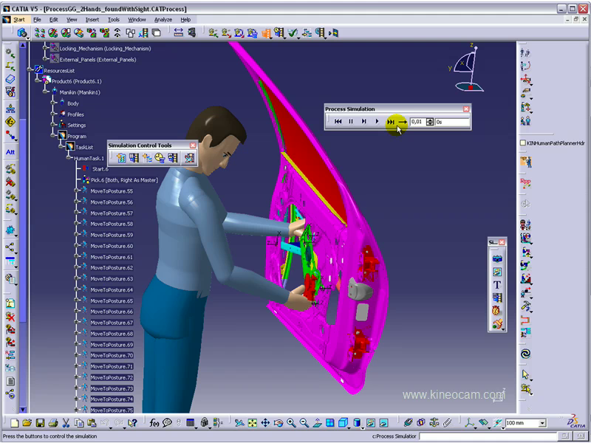
Motion planning

Slide 15
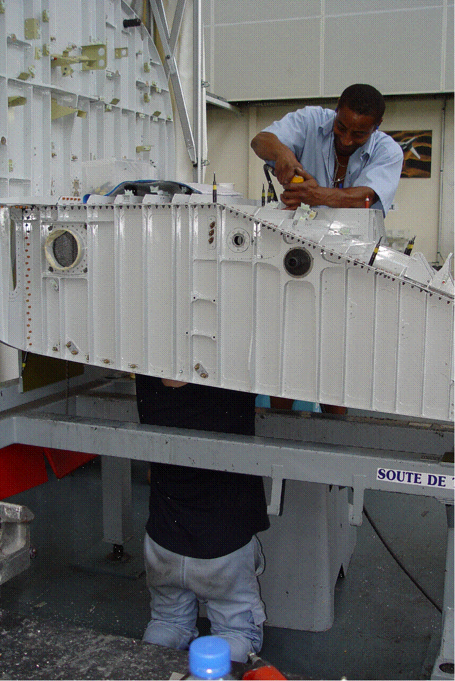
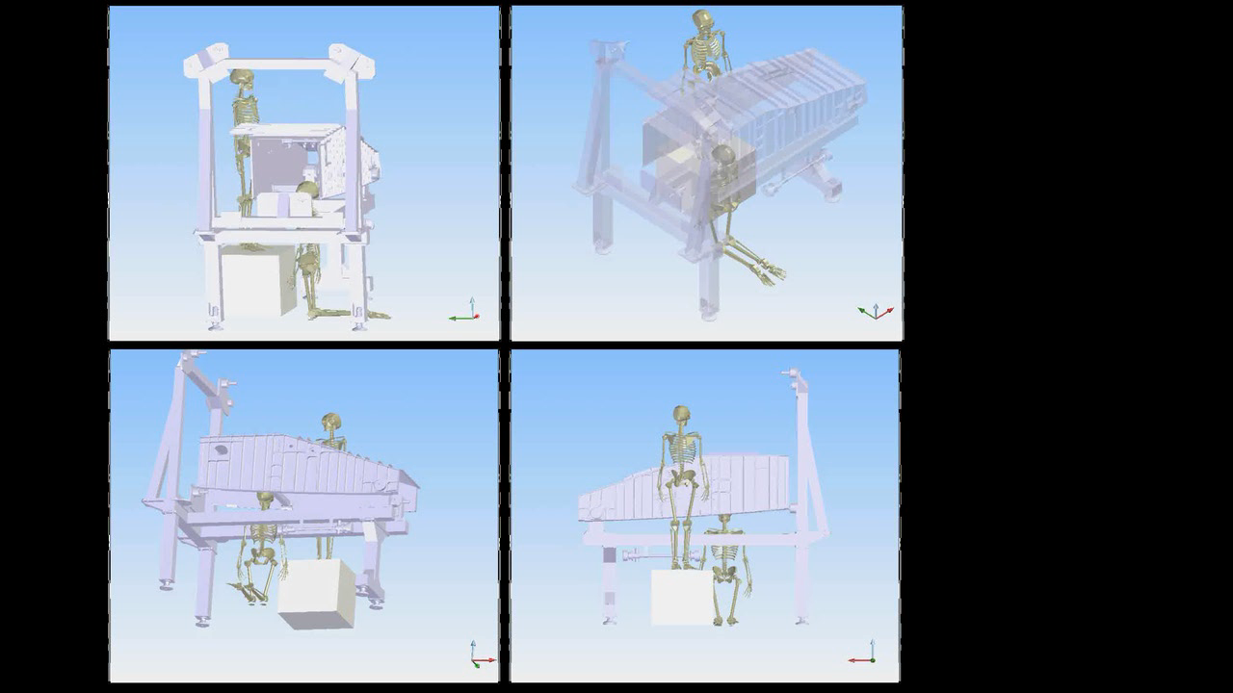
Motion planning

Slide 16
Motion planning
From to
From kinematics to dynamics !

Slide 17
Motion planning
[video]
Why is dynamics so critical?

Slide 18
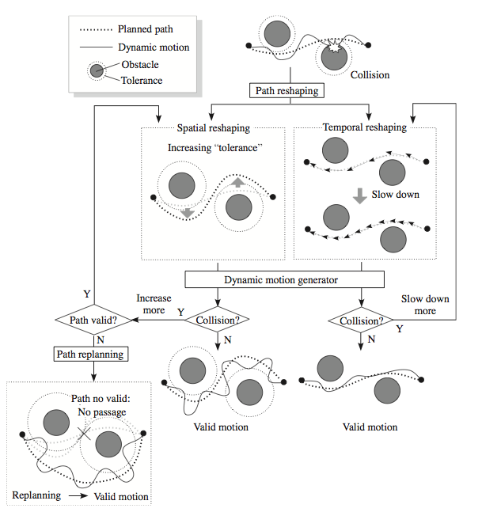
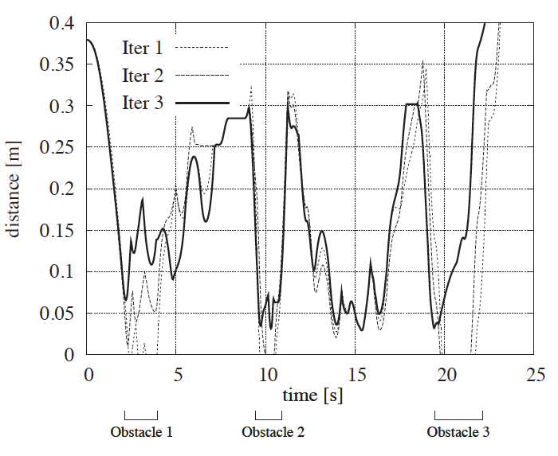
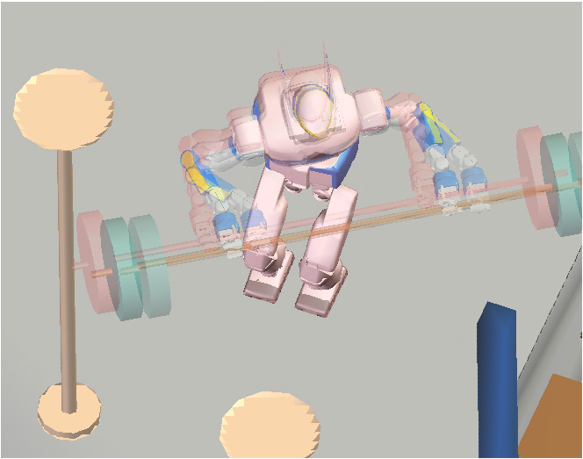
Motion planning
Iterative algorithm based on dynamical simulation

Slide 19
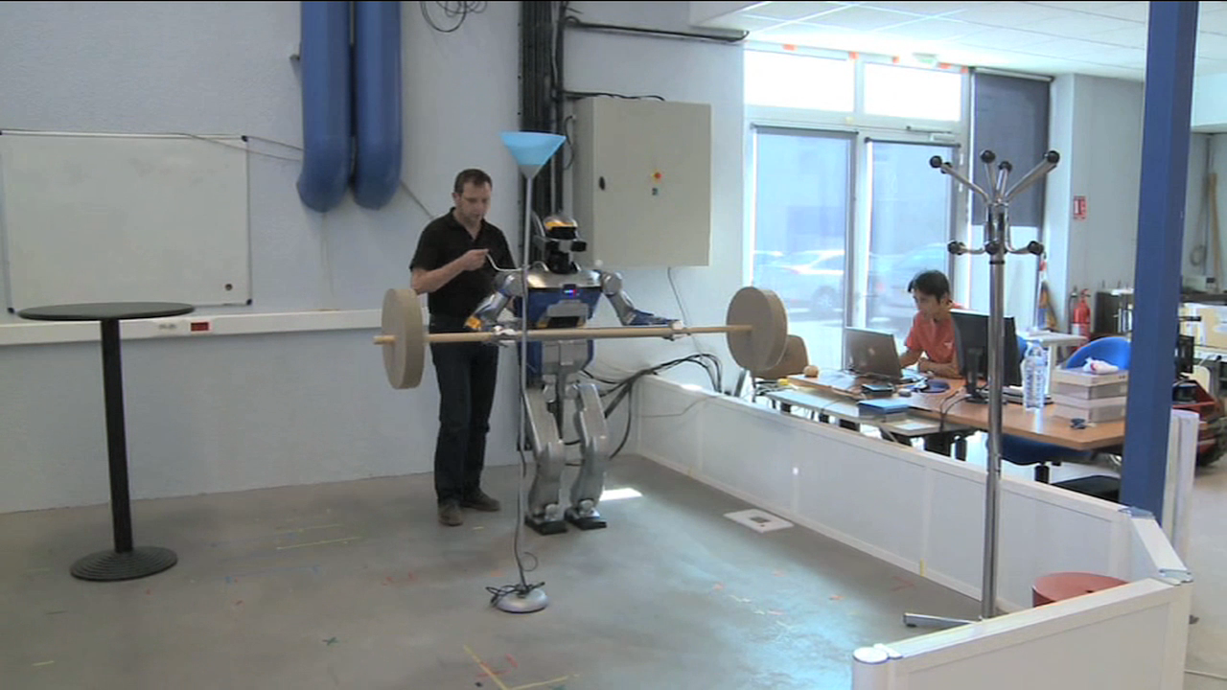
Motion planning

Slide 20
Anthropomorphic systems
Human body:
A highly redundant system
Locomotion: a underactuated system
Challenge: Whole body motion understanding
Do not separate arms from legs !

Slide 21
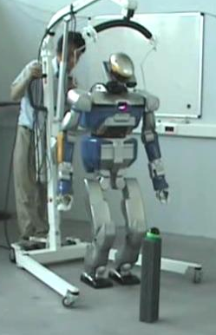
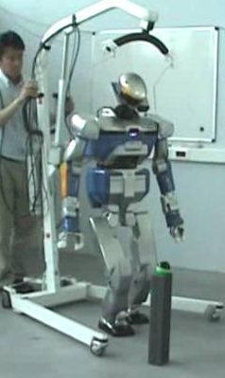
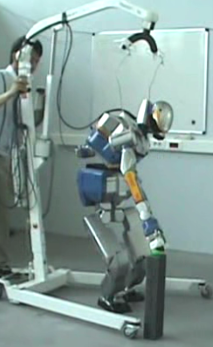
Whole body motion planning
Problem statement: grasping requires stepping

Slide 22
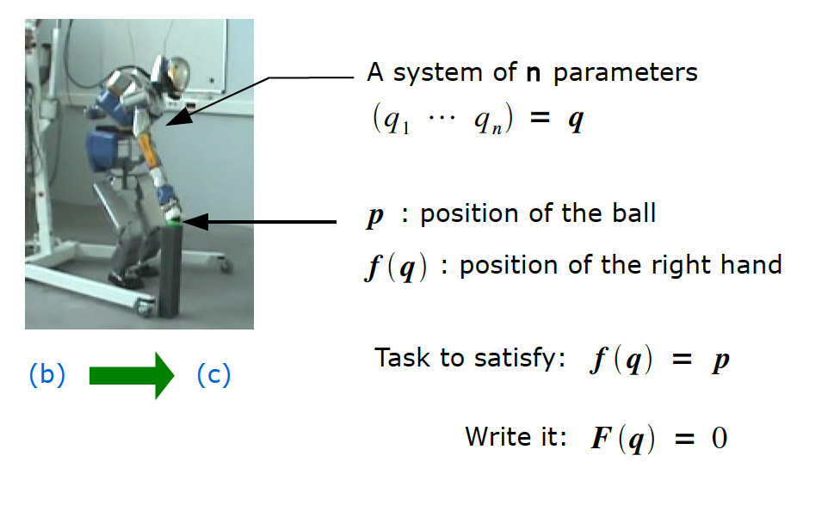
Whole body motion planning
Task function approach (see courses on redundant systems)

Slide 23
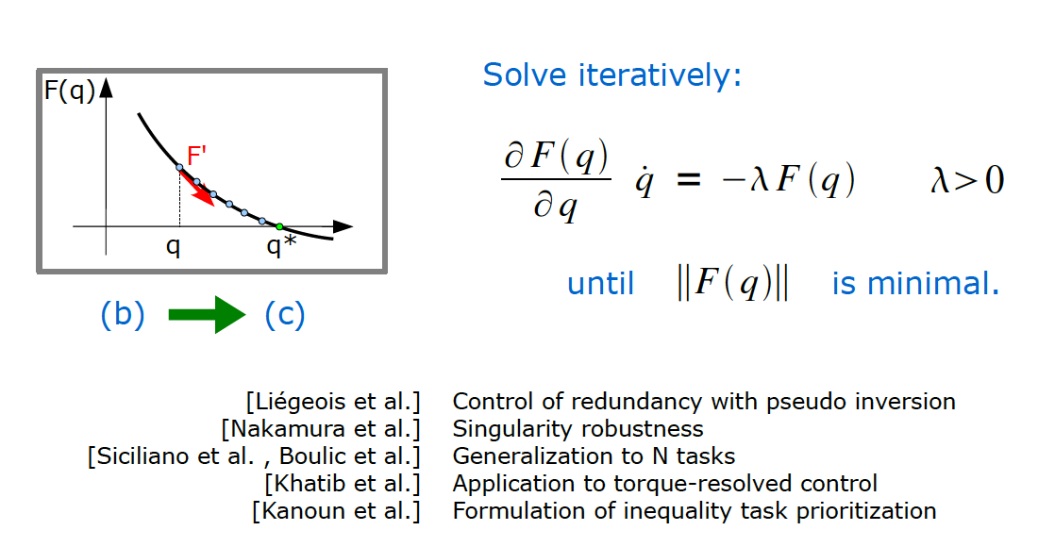
Whole body motion planning
Task function approach

Slide 24
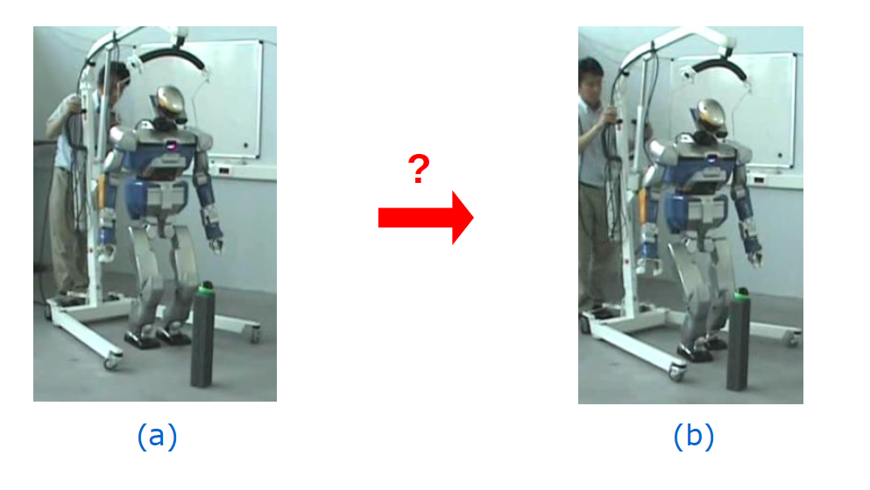
Whole body motion planning
How to model stepping as a task?

Slide 25
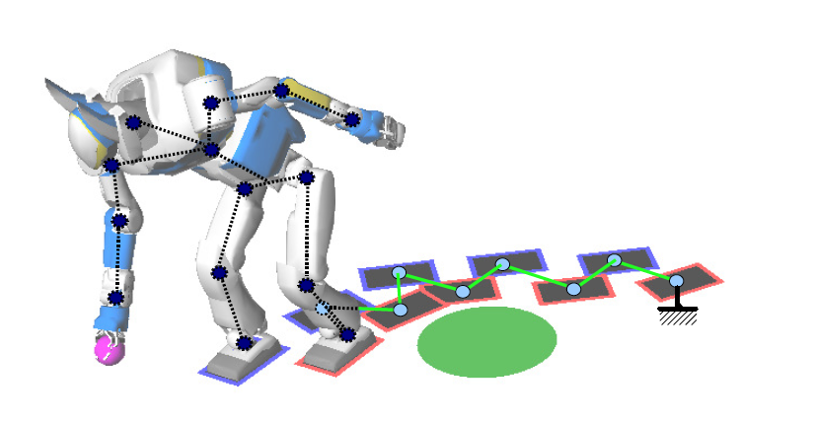
Whole body motion planning
Consider footprints and robot as a virtual manipulator

Slide 26
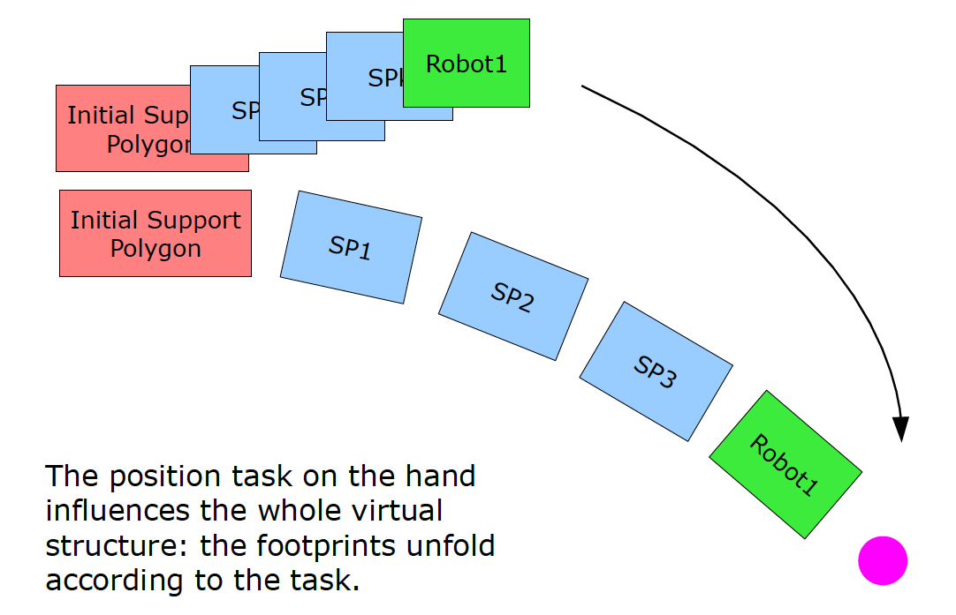
Whole body motion planning
Consider footprints and robot as a virtual manipulator

Slide 27
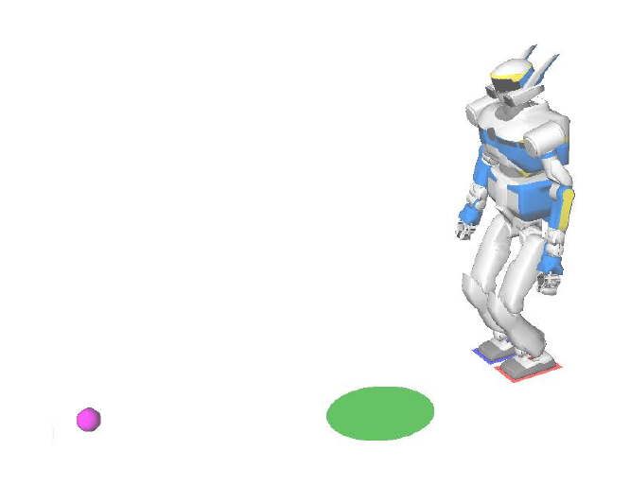
Whole body motion planning
Scenario: reach the ball

Slide 28
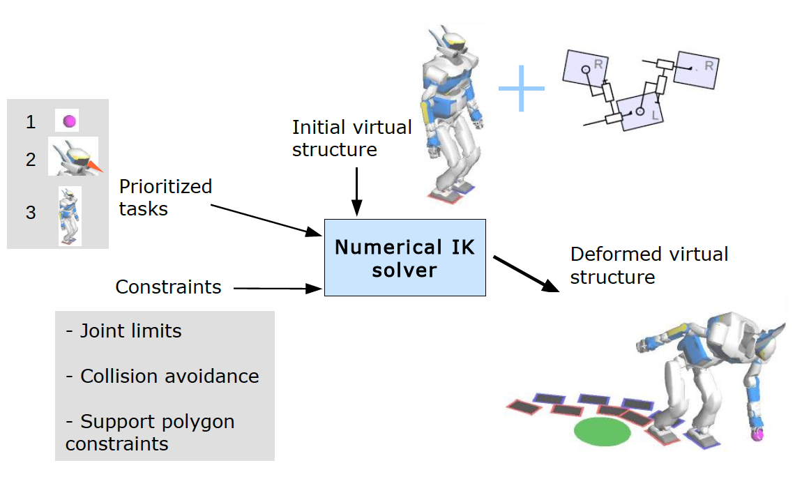
Whole body motion planning
Scenario: reach the ball

Slide 29
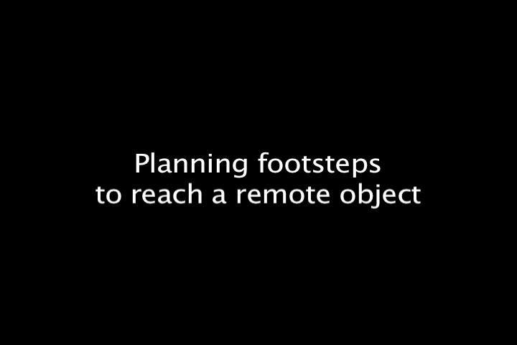
Whole body motion planning
Scenario: reach the ball

Slide 30

Whole body motion planning
Scenario: reach the ball

Slide 31
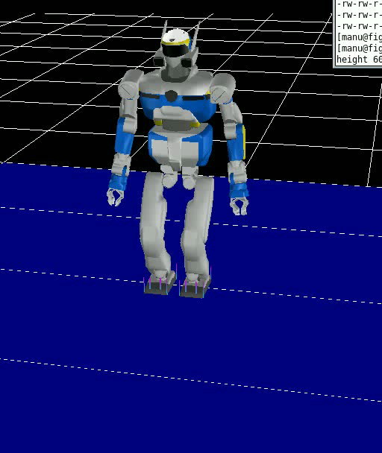
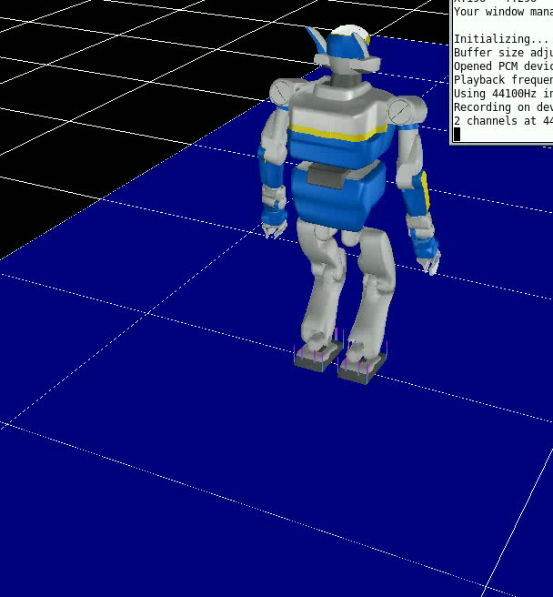
Whole body motion planning
Grasp in front Grasp behind
The need of complementary models.

Slide 32
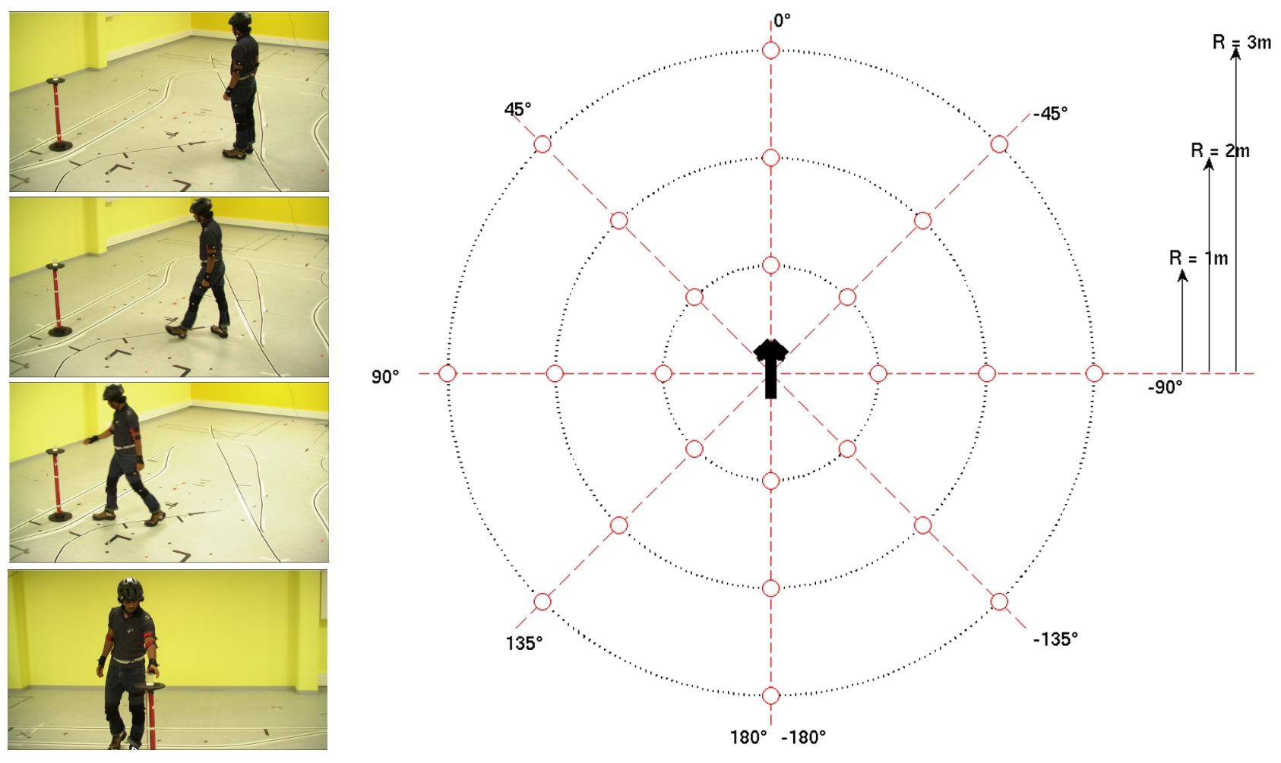
Human behavior based models
The need of complementary models.

Slide 33
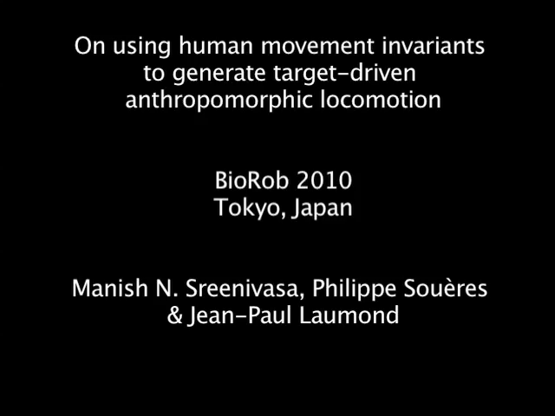
Human behavior based models

